Slide 1
Achieving Real-Time Business Operations
— Huawei Solutions for SAP HANA
Notes:
Hello and welcome to the Huawei HCS pre-sales training course. In this course, we will take you through the Huawei SAP HANA appliance solution, teach you the basic sales scenarios of the Huawei SAP HANA appliance, and prepare you for sales opportunities in future projects.

Slide 2
Contents
1
Challenges Resulting from the Rapid Growth of Enterprise Data
2
Huawei Solutions for SAP HANA
3
Success Cases
Notes:
This course consists of three parts. Let's first look at the challenges facing customers amidst the rapid growth of enterprise data.

Slide 3
Changes Brought to Hardware Infrastructure by Enterprises' Upgrade to S/4HANA
HANA as a Platform
The SAP Business Suite will reach the end of maintenance by 2025.
Search
Predictive analysis
Machine learning
After the current system is migrated from UNIX to S/4HANA, which is based on in-memory computing, how should the hardware infrastructure adapt to the changes?
Spatial analysis
Text mining
HANA
2010
2012
2014
2016
2021
How to value the data
faster and better?
...
BW
HANA
SoH
HANA
S/4
HANA
Accelerator
How to process data
faster and better?
All on HANA
ERP
CRM
Hybris
BW
HANA
SRM
Notes:
力拓未来：* SAP合作，openlab吸引ISV和新客户 * demo用来拓展客户 *华为做为客户的分享及应用

Slide 4
Enterprise Transformation Calls for an Open Business Critical Infrastructure
Enterprises not only generate data, but also need to explore the value of the data
供应链
Agile
The SAP system infrastructure from closed Unix-Server to open Linux X86 platform
Reliable
Trustworthy
Customers don't want separate hardware components, but professional, trustworthy SAP one-stop system infrastructure design and services.
Notes:
As mentioned in previous slides, to thrive in the landscape of the modern world, enterprises must transform, which requires an open mission critical service environment. This leads to the following three conclusions:
1. Enterprises need more than just data. Instead, they need effective methods for thoroughly exploring and extracting big-picture meaning from data to support new business development, respond to market demands quickly, and improve operation efficiency. All these features call for a high-performance infrastructure that supports agile services and real-time decision-making.
2. As SAP mission critical services are shifting from a RISC-based environment to an x86-based environment, higher requirements are placed on the reliability of x86 platforms.
3. Instead of seeking different components from different vendors, customers expect professional, trustworthy partners who can deliver one-stop infrastructure solution design and services to handle their SAP workloads. Huawei provides professional, reliant SAP system infrastructure solution designs and services.

Slide 5






Huawei & SAP Joint Innovation Enables Enterprise Transformation
Huawei & SAP Joint Innovation Enables Enterprise Transformation
Innovative IT Infrastructure
Critical Business on Cloud
IoT Intelligent Interconnection
SAP ECC
SAP HANA
SAP B1
Online Apps
SAP HANA E2E infrastructure
Real-time service decision-making
Innovative and open IT architecture
Cloudified SAP Apps and SAP HANA
Less CAPEX for enterprises
Simplified IT O&M
Intelligent manufacturing solutions for industries
E2E IoT implementation
Notes:
Currently there are three major types of solutions that have been derived from the collaboration between Huawei and SAP.
The first type of solution is end-to-end SAP HANA and S/4 HANA infrastructure. These solutions run on Huawei's innovative IT infrastructures to optimize and improve the running efficiency of SAP HANA and fully support the future-proof OLAP-OLTP converged architecture of S/4 HANA. Meanwhile, the open infrastructure platform helps businesses step out of the traditional closed IT architecture. Soon, Huawei will release the leading-edge 16-/32-socket hyperscale HANA appliance, which supports a single-node 12 TB or 24 TB HANA capacity and can ideally replace midrange computers while maintaining the same level of capacity and performance.
Type two: SAP applications and SAP HANA cloud solutions built around Huawei's cloud operating system, the FusionSphere. These solutions enable enterprises to obtain SAP products and services through clouds and drive down CAPEX as well as simplify IT O&M.
Type three: IoT solutions. These solutions are positioned for multi-industry application and leverage the advantages of Huawei and SAP in the IoT domain as well as Huawei's expertise in wireless LTE, terminals, SAP-based industry practices, and Big Data analytics.

Slide 6

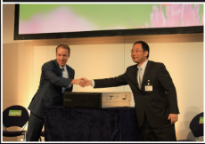
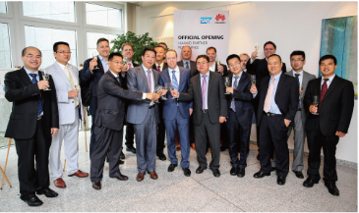
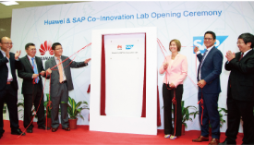
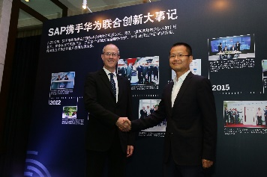
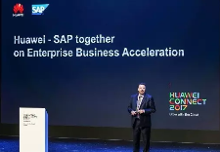

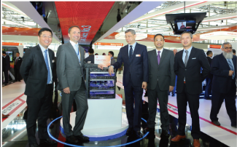
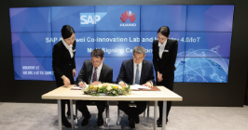
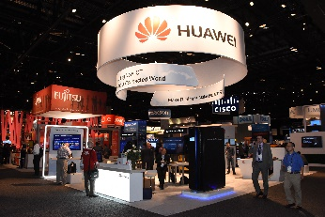
Huawei and SAP Join Hands to Build Leading Solutions
July, the China SAPPHIRE conference SAP announced Huawei as its first global technical partner in China.
February, Huawei and SAP together released the first certified SAP HANA@ appliance solution
July, Huawei Day was held at Walldorf, Germany, the SAP headquarter, meanwhile celebrating the official opening ceremony of Huawei Partner Port Office.
June, Huawei and SAP announced the official opening of the Huawei & SAP Co-Innovation Center in Shenzhen.
June, SAP Greater China and Huawei Enterprise China jointly held SAP | Huawei Forum Shenzhen.
September, as top-class sponsor, SAP attended Huawei Connect 2017 in China, announced big data, cloud business
2012
2013
2014
2015
2016
2017
2017
September, Mr. Ren Zhengfei and Mr. Jim Snabe, met each other and agreed on setting up strategic partnership.
March, Huawei and SAP announced extending the SAP & Huawei collaboration into a strategic alliance.
March, Huawei and SAP signed a MOU at CeBIT 2015 to deepen collaboration in Industry 4.0 and the IoT, which marked the two partners have advanced into the Industry 4.0 era.
May, as a top-class sponsor, Huawei attended the SAPPHIRE NOW 2016 global flagship conference held by SAP in Orlando, USA.
March, release KunLun Engineered System for SAP HANA based on SAP and Huawei joint innovation and optimization.

Slide 7
Contents
1
Challenges Resulting from the Rapid Growth of Enterprise Data
2
Huawei Solutions for SAP HANA
3
Success Cases
Notes:
Next we'll take a closer look at the Huawei SAP HANA appliance solution.

Slide 8

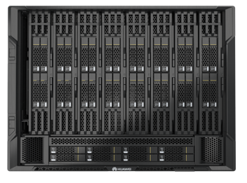
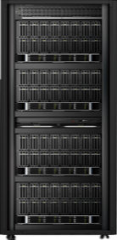
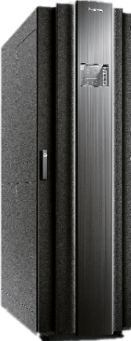
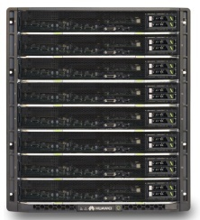
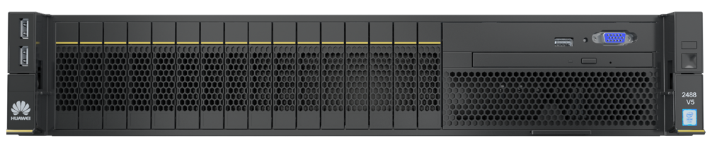
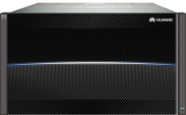
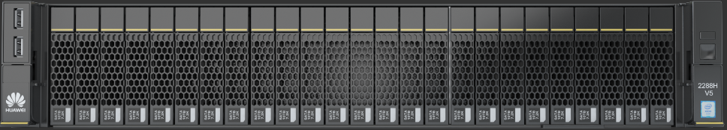
Comprehensive Portfolio of Huawei HANA Solution
Single Node
Scale-out
Tailored Data Center
Business Warehouse on HANA,
S/4HANA, and Business Suite on HANA
Business Warehouse on HANA
SAP Business Warehouse on HANA
S/4HANA and Business Suite on HANA
8100 V5 (8P)
FusionServer
FusionServer
KunLun
2488H V5 (4P)
2288H V5 (2P)
KunLun (32P)
OceanStor
OceanStor
Huawei 32P Server
HANA solution
Large scale HANA cluster
Leading Storage
Products
Dorado
32 HANA Nodes/Cluster
Future
Future
4,000,000
IOPS
200μs write latency
192G
384G
768G
1.5T
3T
6T
12T
16T
More
3T
6T
12T
96T
More
* 16 TB: certified; 20 TB: planning for certification; 20 TB and above: certified case by case
Notes:
Currently Huawei's line of SAP HANA appliance solutions is the most diverse, and therefore able to satisfy a wide range of customer requirements.
SAP HANA appliances can be categorized into single nodes, clusters, and tailored data centers, which are also called TDI, or tailored data center integration, solutions.
Single nodes support data warehouse scenarios based on the OLAP model, and ERP and CRM application scenarios based on the OLTP model. For these solutions, Huawei offers 2-socket servers and 4-/8-/16-/32-socket SAP HANA appliances. The 16- and 32-socket SAP HANA appliances are currently in the process of being certified.
The cluster solution applies to OLAP-based data warehouse scenarios.
Customized by SAP, TDI solutions are composed of SAP-certified HANA servers and storage devices. They can come in flexible combinations, allowing customers to reuse parts of their existing storage utilities. However, TDI is not a mainstream solution, as it may involve integration of devices across different vendors. SAP places the responsibility for end-to-end performance and delivery of the solution on the customers. Currently, over 95% of customers choose the single-node and cluster solutions, which are delivered by hardware vendors.
The unique acceleration technologies involved in Huawei's SAP HANA solutions will be explained in greater detail later.

Slide 9
Single-Node Solutions Enable Enterprise Business System Scale-Up
Single Node Solution
KunLun 9016
FusionServer 8100 V5
FusionServer E9000 V5/ 2488H V5
FusionServer 2288H V5
Q3
192GB
……
1.5TB
……
3 TB
4 TB
6 TB
12 TB
16 TB
2S (56 cores)
FusionServer
KunLun
4S (112 cores)
8S (224 cores)
16S (384 cores)

Slide 10
Cluster Solutions Enable BW System Smooth Scale-Out
Scale Out Solution
FusionServer 8100 V5
FusionServer E9000 V5/ 2488H V5
96TB
(16 nodes)
48TB
(16 nodes)
FusionServer
3TB
……
3 TB
……
6 TB
4S (112 cores)
OceanStor
8S (224 cores)

Slide 11
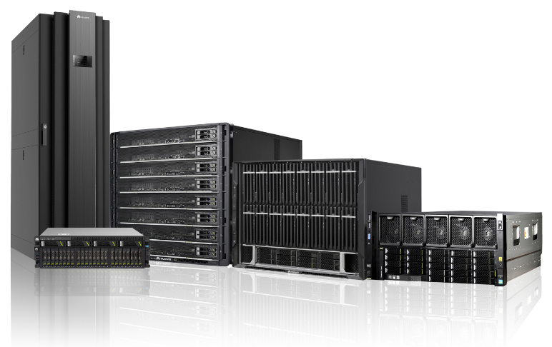

Highlights of Huawei SAP HANA Solutions
Agile
Real-Time Decision
Top1
HANA Benchmark
*Top1 SAP BW edition for SAP HANA Benchmark (B4H)
Reliable
Trustworthy
Non-Stop Services
Best Practice
Huawei Solutions for
SAP HANA
Notes:
Huawei is a trustworthy partner and offers agile, reliable, and professional SAP HANA appliance solutions to enable real-time decision-making and always-on services for customers.
Let's look at an example of Huawei solution agility. In the proof of concept testing for CNPC, Huawei deploys an SAP HANA solution that requires only half of the IBM HANA hardware configuration but delivers five times better performance for indicators such as complex queries and data loading. The outstanding performance can be attributed to the low-delay, high-bandwidth storage network design of the Huawei HANA appliance. In addition, a reliability design has been applied at every level of the Huawei HANA solution, from solution to component, bringing the customer's overall system availability to a new, high level.
Huawei has delivered large-scale SAP HANA system design and implementation best practices through projects such as the 87 TB HANA cluster for Sinopec, the 63 TB HANA cluster for CNPC, and the 40 TB HANA for SAP Labs China.

Slide 12
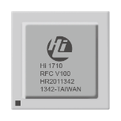

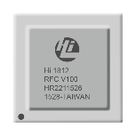
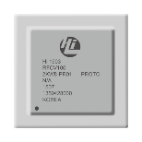
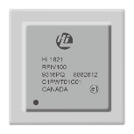
Agile
Reliable
Trustworthy
Success Based on Continuous Innovation: Cultivating Competitive Differentiation at the Chip Level
Hi1503
CPU interconnect chip
Scale-up industry
Hi1710
BMC mgmt. chip
Enhanced RAS
SSD
Management
Hi1822
Network control chip
DC high-speed and
flexible interconnect
Hi1812
SSD storage control
Read/Write I/O
acceleration
SSD storage
control
CPU interconnect
DC interconnect

Slide 13
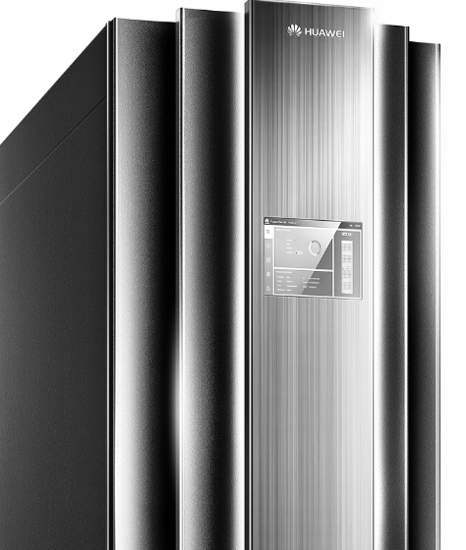


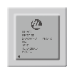

Agile
Reliable
Trustworthy
High-Performance KunLun SAP HANA Appliance
— Scale-up Innovation
Business Warehouse
Pure HANA
Business Suite and S/4
SAP
HANA
SAP
HANA
SAP
HANA
32 CPUs
High Performance Computing Capability
16/*32TB HANA
Largest HANA memory size of HANA single node
RAS 2.0
Highest levels of
RAS features
KunLun 9016/9032 Mission-Critical Server
Huawei Proprietary Node Controller Chip
Huawei Proprietary Management Chip
Efficient, flexible computing resource
scale-up
Enhanced RAS features
* 16 TB: certified; 20 TB: planning for certification; 20 TB and above: certified case by case
Notes:
Now, let's talk about the innovation behind the Huawei SAP HANA appliance from the scale-up perspective.
Huawei KunLun server can be scaled up to 32 CPUs, supports a maximum of 24 TB HANA database memory per server, and leverages RAS 2.0 technologies to improve overall system reliability.
The high performance results from two core innovation capabilities of Huawei. First, Huawei's proprietary Node Controller chip technology, which enables a single server to accommodate up to 32 CPUs. Second, Huawei's home-built management chip and reliability enhancement technologies, which transform the reactive reliability insurance system into a proactive RAS 2.0-enhanced highly reliable system.

Slide 14
Agile
Reliable
Trustworthy
More Powerful Big Capacity HANA Appliance
Smoothly Expandability
Top1 HANA Benchmark
Extreme Reliability
32 TB
RAS 2.0
20 TB
16 TB
8 Hours
Downtime for a 6TB HANA maintenance
0 Hours
MEM hot maintenance
12 TB
128GB
~8TB
HANA@KunLun
8P
16P
32P
*16 TB: certified; 20 TB: planning for certification; 20 TB and above: certified case by case
*Memory hot maintenance of KunLun HANA appliance plan to be launched before 12/31/2017.
Notes:
There are some customer requirements for more that 20TB, HUAWEI-BPIT, Italy TI, Switzerland sunrise, Thailand PEA, PICC, China Life and other important customers
ECI, a European largest department store, has made clear the need get the certification of using KunLun to BW/DataMart.

Slide 15
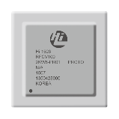

Agile
Reliable
Trustworthy
SAP HANA Scale-Up Performance Higher Than Scale-Out Performance
— CPU high-speed interconnect reduces data transmission delay on networks from milliseconds to nanoseconds, enabling quicker service response
DB 1
DB 2
DB 3
DB n
DB 1
...
Intra-server interconnection
Cores
...
Shared Memory
Shared Memory
Shared Memory
Shared Memory
NC Interconnection Chip
Inter-server interconnection
Shared Memory
HANA Scale-out
HANA Single Node
  Up to 8 CPUs per system
  Inter-server network delay in ms, including CPU processing delay, network adapter processing delay, and link transmission delay
  32 CPUs per KunLun 9032 system, 16 CPUs per KunLun 9016 system
  High-speed CPU network delay in ns, allowing quicker service response
Notes:
The SAP HANA solution can be implemented based on the scale-out or scale-up technology. The scale-out technology enables high-performance SAP HANA distributed clusters, where the interconnection between HANA databases within the cluster require interaction between server NICs, external switches, and the application layer, resulting in an end-to-end delay of milliseconds.
Huawei's KunLun-based SAP HANA appliance uses the scale-up technology. Composed of 32 CPUs in a server, KunLun reduces the data exchange delay between CPUs to nanoseconds.
Therefore, from the technology point of view, the scale-up architecture of Huawei SAP HANA appliance delivers higher performance than the scale-out architecture of other vendors' solutions.

Slide 16

Agile
Reliable
Trustworthy
All Flash HANA Appliance Improve 3~6X Performance
—— More storage IO bandwidth boost the HANA system performance
240x faster (SSD VS. HDD)
3x~6x Improvement in HANA Performance
Save 0.5~4 hours M&O time
ES3000 SAS SSD
200,000 IOPS; 1,050 MB/s bandwidth
↑
3.2x
↑
4.2x
↑
5.8x
↑
6.1x
4KB data block random read IOPS
Unit: Second
Source: By Test
Notes:
Now, let's look at the innovations behind the Huawei SAP HANA appliance from a single-node perspective: storage media acceleration and HANA database performance acceleration through Huawei PCIe SSD cards.
Huawei is the only vendor in the world to use PCIe SSD cards for log volume acceleration across the entire line of SAP HANA appliances. This application is advantageous especially in OLTP-based scenarios such as ERP, ECC, and CRM. The PCIe SSD cards slash the write delay to 15 μs, and deliver an IOPS of up to 700,000, which is a several hundred times increase from traditional SAS disks. Huawei has been exploring PCIe SSD cards to differentiate its SAP HANA solutions from the competition. Huawei's confidence in this area stems from its long history of constant investments in R&D and innovation of PCIe SSD cards. Leveraging its technical strengths, Huawei is able to offer SAP HANA appliance solutions that deliver an optimal balance of cost-effectiveness and high performance.
Other vendors have not been able to make the breakthroughs that Huawei has. For example, instead of using SSD cards for log volume acceleration, IBM uses only SSD disks as cache for its memory configuration.
None of HP's HANA appliances are configured with SSD disks, whereas Huawei's HANA solutions offer SSD and SAS HDD configurations, allowing customers to choose according to their budgets.
And vendors such as Dell and Fujitsu use SAS disk technology for log volumes, which achieves a low performance.
Huawei uses the ES3000 PCIe SSD card, which at present delivers the highest I/O performance for HANA log volumes in the world, according to a third-party evaluation by StorageReview.
In the case of a HANA single-node fault, during node restart, competitors' devices read log data from SAS disks, whereas Huawei's device reads data from PCIe SSD cards that support an IOPS of 700,000. Reading data from PCIe SSD cards is far more efficient than reading data from SAS disks.

Slide 17
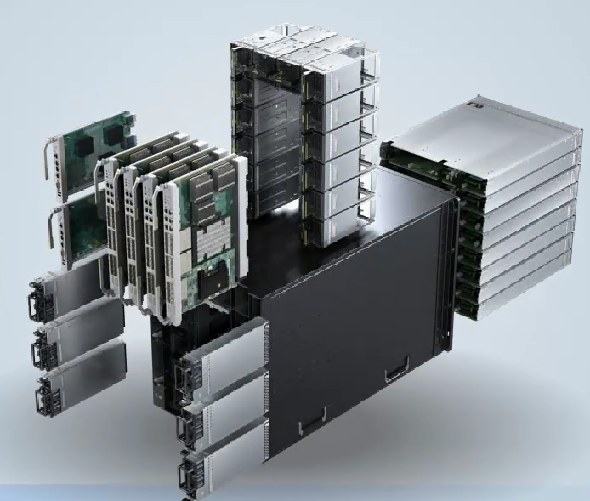
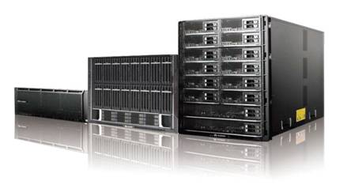

Agile
Reliable
Trustworthy
Enterprise-Level Reliability Ensures Stable Service Running
Solution-level Reliability
Proactive Failure Analysis Engine
Modular Design and Hot swap
Patented Wear-Leveling Algorithm Extending SSD Lifespan
Backup
Without Wear Leveling
Production Site
RAS 2.0
System Replication
With Wear Leveling
DR Site
Notes:
Huawei SAP HANA appliance ensures stable operating for customers' SAP systems at every level, from the solution reliability design to each server and hardware module component.
For example, Huawei improves the solution's availability through the SAP system backup and disaster recovery design.
By using server RAS 2.0 proactive fault prevention technologies and highly modular technologies for rack and blade servers, Huawei improves server reliability.
As a key acceleration component of the Huawei HANA appliance, the Huawei PCIe SSD card is enhanced with a patented wear leveling algorithm to prolong the service life to five years.

Slide 18
Innovative RAS 2.0 Technologies Improve Reliability
Agile
Reliable
Trustworthy
RAS 2.0
NC chip
BMC chip
...
Processors
Chips
+99.999% Reliability
PFAE
Firmware-level Fault Response and Diagnosis
...
OS / App
Proactive Failure Analysis Engine
Memory Hot Swap
Firmware
Standard and Open
Hardware of High Reliability
Partners
A New Standard of Reliability
Huawei
* Memory hot maintenance of KunLun HANA appliance plan to be launched before 12/31/2017.
Notes:
RAS 1.0 was intended for realizing all the RAS features offered by the Intel E7 series processors to build a fundamentally reliable mission critical service platform.
Intel Xeon E7 v3 processors integrate Intel's latest comprehensive RAS features and deliver higher reliability than Itanium processors.
However, most suppliers failed to provide all the above-mentioned RAS features, because that requires a number of extra firmware development workloads (instead of using Intel's public version BIOS) or a complete set of solutions (including hardware, Intel firmware, OEM firmware, and Linux development).
However, RAS 1.0 is based on a general fault handling system that centers around the operating system and has a number of drawbacks. When it comes to fault preventions, the operating system is generally reactive. It is susceptible to uncorrectable errors and easily crashes as a result of these errors. Therefore, it is difficult to collect comprehensive fault information, which complicates fault reproduction and affects O&M efficiency. In addition, RAS 1.0 does not support hot swap for key components such as CPUs and DIMMs. Statistics show that, among hardware faults, DIMM faults are second in frequency only to hard disk faults. Therefore, supporting hot swap for key components will dramatically improve platform reliability.
Huawei developed RAS 2.0, which not only realizes standard RAS features but also resolves these aforementioned problems and offers enhanced RAS features, including:
Out-of-band Proactive Failure Analysis Engine (PFAE): This feature automatically collects comprehensive fault information, performs online diagnostics, provides warnings about risky components, and transfers tasks running on risky components to other resources, thereby minimizing downtime. PFAE also provides real-time online maintenance and planned maintenance functions.
Precise fault locating: This feature quickly locates the root cause of faults to allow for fast and precise recovery.
Partitioning function: This feature supports hard and soft partitioning, allowing customers to select a suitable partitioning mode according to service requirements to maximize resource utilization.
Hot-swappable CPUs and DIMMs: Huawei SAP HANA appliance is the industry's only solution that supports CPU and DIMM hot swap. It reduces the system down rates caused by CPU or DIMM faults by 94% and 97% respectively, maximizing system uptime.
NC RAS features: Supports Node Controller, or NC, link level error correction, and full link redundancy.
Huawei currently offers the industry's highest level of RAS features for open platforms. RAS 2.0 achieves over five-nine, that is, over 99.999%, reliability. Some of its key features surpass those of high-end midrange computers.

Slide 19




Agile
Reliable
Trustworthy
High-Reliability HA and DR Solutions Ensure Business Continuity
— HA Solution Composed of Huawei + OS + SAP HANA
Automated
Avoid human-factor
errors
Quasi-Real-Time
A great leap
in reliability
Lower TCO
No need for
3rd-party
HA software
Simple
Deployment
Professional HA
implementation
Extensive
Experience
DR experience of
1300+ km
Client
App Server
Distance: 1300+ km
Bandwidth: 150 Mbit/s
RPO: seconds
Operation System HA Cluster (Virtual IP)
HANA agent
Heartbeat
Monitor
Monitor
Primary
System
Replication
Secondary
(active)
(active)
(data pre-loaded)
Beijing: production center
Jilin: DR center
HANA
HANA
Data Disks
Log
Disks
Data Disks
Log
Disks
Notes:
SAP HANA的System replication功能实现DB数据的同步或异步复制；
操作系统层自带专业HA软件实现HANA主备节点运行状态的监控和切换；

Slide 20



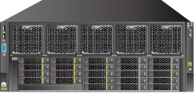

Agile
Reliable
Trustworthy
Trustworthy SAP System One-Stop Solution
8G FC
Business Operator
Business Operator
Configuration Admin
10 GE
10 GE_DR
Uplink
GE
Business Switch
Business Switch
Management Switch
HA
...
HA
...
SAP Application: ERP, HR, CRM
System Replication
SAP HANA Appliance
Switch
Storage Switch
Storage Switch
Storage (SAN)
Backup Storage
DR site Application server + HANA appliance
Notes:
Huawei offers a full spectrum of SAP HANA solutions, including single-node, cluster, and TDI solutions, as well as SAP-certified applications and HANA database virtualization. All these solutions help customers build SAP clouds and comprehensive SAP system HA, DR, backup, and big data tiered storage.
1. Huawei offers the most comprehensive series of SAP HANA infrastructure solutions, including 2-, 4-, 8-, 16-, and 32-socket HANA appliances. Other vendors' solutions do not offer the entire series, lacking the 8-, 16, or 32-socket server.
2. After VMware, Huawei's FusionSphere is the second software that supports SAP HANA database virtualization (for private clouds). This further demonstrates Huawei's prowess when it comes to IT solutions. In addition, Huawei FusionSphere has been certified for virtualization for SAP upper-layer application software such as ERP and CRM.
3. Huawei has developed solid capabilities in planning, designing, and implementing SAP HANA HA, backup, and DR solutions.

Slide 21
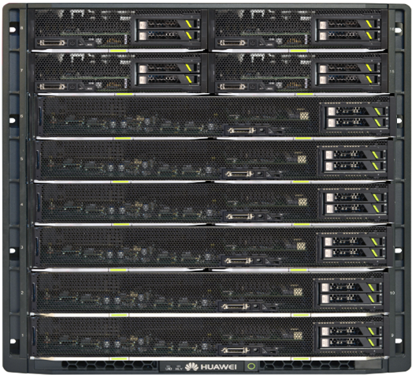
Agile
Reliable
Trustworthy
One Blade Chassis SAP Infrastructure Solution
E9000
Integrate all application and HANA computing nodes into one or more chassis.
Simplify the cabling;
High density;
One Chassis can support 30TB（5*6TB) HANA single node and 6*2 socket application server.
ECC_PRD
ECC_PRD_HA
ECC_DEV
ECC_QA
SAP Application
HANA_PRD 3T
HANA_PRD 3T
HANA_DEV 768G
HANA_QA 768G
SAP HANA
Extension
OceanStor 5500 V3

Slide 22



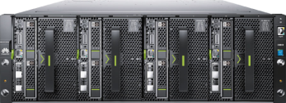


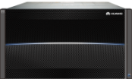

Agile
Reliable
Trustworthy
SAP-Certified Huawei Cloud-Enabled Solution for SAP System
SAP Terminal
Web Browser
Mobile App
Business Interactive
Cloud
Cloud
Management
Router
Web Dispatcher
Huawei ManageOne
SAP APPs
Virtualization
Deployment
Frontend
Server
CRM
BO
ECC
Hyper-converged Infrastructure
Physical
or
Virtualization
SAP
HANA
HANA Database
SAP HANA Appliance
Backup Storage
Notes:
More and more SAP clients are choosing the SAP service layer for virtualization deployment. Huawei FusionSphere has been certified for SAP application. Huawei FusionSphere virtualization software and cloud management software can help customers build an elastic service resource pool that scales on demand. As such, Huawei is able to provide hyper-converged infrastructure that includes HANA appliances and the service layer, together with cloud platform software, to build one-stop solutions with SAP on Huawei cloud infrastructure.
For scenarios where the customer has a large number of service servers deployed, virtualization is recommended.

Slide 23
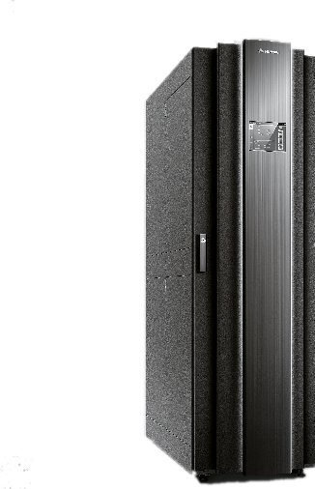



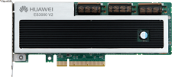


Agile
Reliable
Trustworthy
SAP HANA Data Tiered Deployment Solution with Better Economics
— Tiered Storage with Hadoop, Huawei FusionInsight
Analysis Show
CRM
Public Opinion Analysis
Data Service
ECC
HIVE
Spark
Mining Potential Customers
SAP HANA
SAP
HANA
HDFS
EWM
Behavior Analysis
Hybris
Market Intelligence
High-speed Processing
Structural Data
Classification Mark
Semi-structured Data
HANA
HIVE
Spark
HIVE
Semi-structured Data
Hadoop
PCIe SSD
Log Volume
OceanStor
Data Volume
Notes:
1. When an enterprise's data to be analyzed exceeds around 100 TB and certainly by the time the amassed data reaches the petabyte range, the SAP HANA all-memory solution is necessary. However, this solution has high quotations. To address this problem, the tiered solution can be used. Specifically, the HANA appliance can be used to process hot data, which is data from the last one to six months and which needs to be presented in real time. Hadoop is used to process historical warm and cold data. This represents a Big Data analytics solution that is optimally cost-effective for the customer.
2. Hadoop is able to extract and process data from multiple sources. For example, a car manufacturer can use Hadoop to process unstructured data from various electronic media channels and other data from its internal systems. After being analyzed and processed, hot data may be loaded into the HANA database, for example, for real-time query. The holistic data can be stored in Hadoop for analytics over a longer time.
This solution is one way that Huawei differentiates itself from Lenovo, HP, and Dell who sell only hardware. Though currently not required by customers, this solution adds to Huawei's overall solution capabilities and strengthens Huawei's reputation in the eyes of customers and partners.

Slide 24
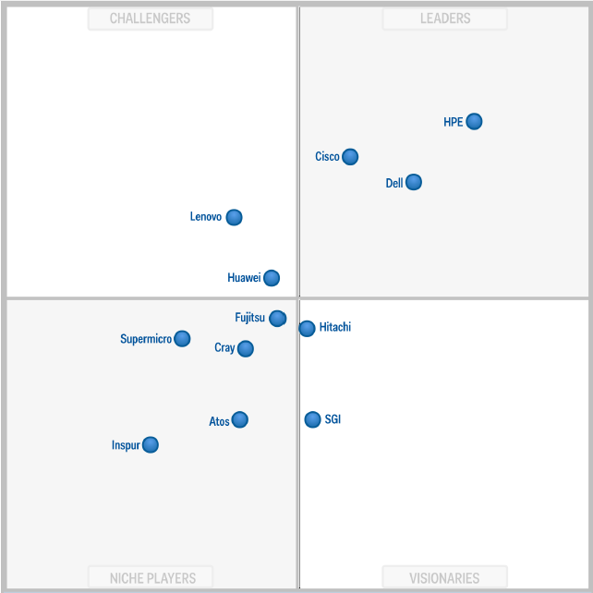

Market Position: Global No. 3 by Shipment and Positioned as a Challenger in Gartner's Magic Quadrant
Agile
Reliable
Trustworthy
Top 3
Global Server
Shipment Ranking
Q2 2017
Challengers
Leaders
Challenger
Magic Quadrant for
Modular Servers
Niche players
Visionaries
Source: Servers_Marketshare_WW_by_Region_2017Q2
Source: MQ of Modular Server, Gartner, 2016

Slide 25
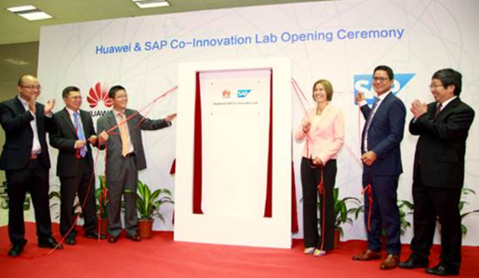
Agile
Reliable
Trustworthy
Globalized R&D Resource and Localized Business Operations
Netherlands
Toronto
Germany
Hungary
Ottawa
Romania
Silicon Valley
China
Mexico
Bahrain
India
UAE
Malaysia
Huawei Headquarters
Brazil
Accounting Shared Service Center
Bidding Center
Mauritius
Supply Center and Hub
R&D Center
Argentina
Training Center
Technical Support Center
Operations in 170+ countries; 170,000+ employees comprised of 160+ nationalities worldwide; 75% localization rate
Huawei’s global value chain allows smooth capability transfer across the globe, develops and retains talent in local countries, and creates jobs and economic opportunities
Notes:
Huawei has built R&D and onshore service teams both inside and outside China. Huawei has teamed up with SAP Germany to establish the SAP Joint Innovation Center. This move improves Huawei's image and better positions the company to offer trustworthy products and professional services.

Slide 26
Why Huawei is The Best Choice for Enterprise？
1000+ SAP HANA Customers
Innovation Award
“Honorable Mention ” Innovation Award in Sapphire
One-Stop Solutions
512GB~32TB HANA; Covered HANA appliance, TDI, SAP cloud, Big data etc. SAP solutions.
Top1 Performance
Of SAP BW edition for SAP HANA benchmark
~0 Downtime maintenance
Only Huawei support memory hot swap
136TB cluster deployment experience of one customer
1300+KM HANA Disaster Deployment Experience
All-Flash SAP HANA Appliance
Save 0.5~4 hours M&O time
25+ industry reference Cases
* MEM hot maintenance of KunLun HANA appliance plan to be launched before 12/31/2017.

Slide 27
Contents
1
Challenges Resulting from the Rapid Growth of Enterprise Data
2
Huawei Solutions for SAP HANA
3
Success Cases
Notes:
In the last section, we'll take a look at the SAP HANA success cases delivered by Huawei.

Slide 28
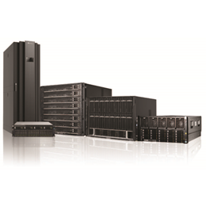





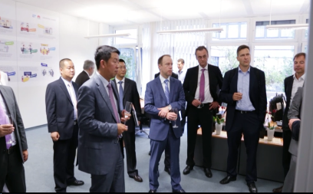


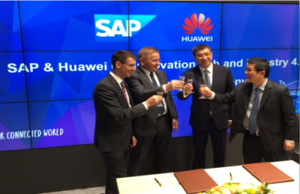
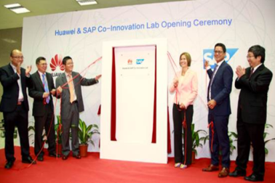


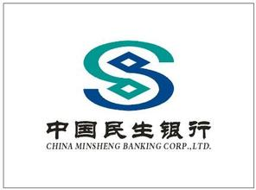

Huawei SAP HANA Solutions Enable Refined Operation for Global Enterprises
Co-innovation labs
40+
Countries
1000+
Customers
25+
Industries

Slide 29
















































































Global Reference Cases
Notes:
Strategic cooperation solutions delivered by Huawei and SAP have been recognized by customers all over the world. Widely used in a number of countries and regions including China, Europe, the Middle East, America, and Africa, Huawei SAP HANA appliances have proven to be a huge success and have been recognized by industry-leading customers. For example, Sinopec selected the Huawei SAP HANA appliance to build an 87 TB hyperscale SAP HANA data warehouse cluster with the hopes of improving its operation analytic performance. CEPSA, also known as Spanish Petroleum Company, adopted Huawei's KunLun SAP HANA appliance to build an ECC on HANA system, which delivered 6 TB per node and improved the company's productivity. With each large-scale SAP HANA system delivery, Huawei gains more experience in building, running, and maintaining SAP HANA systems. Best practices based on the Huawei SAP HANA appliance have been applied in large scale across industries including manufacturing, energy, retail, high-tech, tobacco, and finance. Huawei has become the most trusted expert of the SAP system infrastructure solution.
------------------------------------------------------------------------------------------------------
Huawei's SAP HANA appliances have been serving a number of the world's top 500 companies, including Sinopec, CNPC, COFCO, China Mobile, China Minsheng Bank, Deutsche Telekom, Vodafone, China Minmetals, Yang Quan Coal Industry Group, BAIC Automotive Group, Dongfeng Motor Group, Telefonica, China Shipbuilding Industry Corporation, and China National Aviation Corporation. This recognition from these top 500 companies of Huawei's SAP HANA appliances is a testament to the high quality of Huawei solutions. Huawei SAP infrastructure best practices will continue to serve a wider range of industry customers.
Here is a summary of some of Huawei's projects:
Sinopec: 87 TB business warehouse on HANA
CNPC: 63 TB business warehouse on HANA
CEPSA: 6 TB ERP on HANA per node; 13 TB deployed in 2015; expanded to 30 TB in 2016
Newcastle University: 20 TB ERP, CRM, business warehouse HANA
The first HANA enterprise cloud in Spain
Deutsche Telekom and Telefonica selected the Huawei SAP HANA appliance to build HANA clouds.
The Standard Bank of South Africa, China Minsheng Bank, Anbang Insurance Group, and Zheshang Insurance selected the Huawei SAP HANA appliance.

Slide 30



Retail: 16S KunLun SAP HANA Appliance Drives Faster Time-to-Value and Agile O&M for ECI
Based on all in-memory computing, the 16-socket KunLun SAP HANA appliance delivers up to 100x higher performance than the previous system, empowering ECI with real-time business insights.

Slide 31


Newcastle University Migrates ECC System to Business Suite on HANA with Huawei HANA Solution
10 Sets of Two TB HANA DB + 60 RAS Features + Cover SAP ERP, BW, CRM, SRM, IDM Systems
Improve System Performance by 300 Times
Notes:
Challenges:
Newcastle University's ECC system has been operating for nearly a decade and required enhancement in its overall performance and management. The university planned to migrate its core management systems such as BW, ERP, CRM, SRM, and IDM to the SAP HANA appliance.
Based on advance solution consultation, onsite PoC testing, and successful cooperation experience with Huawei, Newcastle University finally chose Huawei SAP HANA appliances and deployed applications to the business warehouse on HANA and business suite on HANA platforms.
Huawei solutions:
Newcastle University purchases a large number of SAP HANA appliances based on RH8100 V3 and RH5885H V3, with a total memory capacity of up to 20 TB.
Built on innovative hardware architecture, Huawei SAP HANA appliance is designed with excellent computing and expansion capabilities to ensure stable and effective service operations. This appliance is perfect for Newcastle University's business warehouse on HANA and business suite on HANA platforms.
With Huawei high-performance ES3000 PCIe SSDs, Huawei SAP HANA appliance provides ultra low latency and ultra high IOPS processing capability.
Customer benefits:
Huawei SAP HANA appliance perfectly meets HANA in-memory databases' requirements on low I/O latency. RH8100 V3 delivers RAS 2.0 features to achieve high reliability and usability equivalent to midrange computers, ensuring the stable operation of Newcastle University's core services.
Huawei SAP HANA appliance supports the stable operation of Newcastle University's core management systems, including the BW, ERP, CRM, SRM, and IDM. The system performance is improved by 300-fold.

Slide 32

CNPC Improves Business Warehouse Performance with Huawei Scale Out Solution
136 TB HANA DB + 100,000 IOPS + Hyper-converged Infrastructure,
Easy Adaption to Tens Times Performance Acceleration Business
Notes:
After a year of stable operations, CNPC’s HANA data warehouse cluster was expanded from 63 TB to 136 TB.

Slide 33
Notes:
That's all for this training session. Thank you.

