Slide 1
Huawei OceanStor 9000 Quotation Guide

Slide 2
Contents
1
System Introduction
2
Product Configuration Guide (initial and expansion)
3
Service Configuration Guide
4
eDesigner Solution Configuration Guide

Slide 3
Configuration Tools
eDesigner
UniSTAR and SCT
Solution scenario-specific configuration tool that provides different templates in different scenarios after parameters are inputted. The tool can output configuration solutions, technical proposals, networking diagrams, topologies, as well as performance and capacity evaluations.
Outputted configuration solutions can interconnect with BOQs generated by SCT by one click.
OceanStor 9000 supports configuration templates for media, video surveillance, and high-performance computing scenarios.
Website of eDesigner: http://app.huawei.com/unistar/edesigner/solutionAction!showHome.action
Product configuration output tool that allows users to input parameters regardless of scenarios.
Enterprises in and outside of China use SCT while carriers worldwide use UniSTAR. Users must apply for different configuration permissions. The two tools share the configuration algorithm.
Website of SCT: http://app.huawei.com/sct/queryProductAction!queryProduct.action
UniSTAR in China: UniSTAR CFG for AppSoft & IT China
UniSTAR outside of China: UniSTAR CFG for Wireless & Core Network & IT Oversea

Slide 4
Dynamic Configuration
The OceanStor 9000 configuration package uses dynamic configuration, which is implemented by configurators for global enterprises and carriers outside of China. Different node configurations are automatically packed as code. Since carriers in China adopt different purchase modes, they still use independent sub-component code.
After the configuration, perform the following steps to generate instance code. On SCT, choose Config Result > More > Instantiation.

Slide 5
Addresses for Downloading Configurators and Applying for Permissions
Websites for applying for configurator permissions: http://w3.huawei.com/dominoapp/it/isr/unistarcfg/unistarappflow.nsf/fmMain?Openform
Website for downloading the UniSTAR client: http://cfg.huawei.com:8080/WebUI/index.jsp
Website for accessing SCT: http://app.huawei.com/unistar/sct/queryProductAction!showHome.action?#
Website for accessing eDesigner: http://app.huawei.com/unistar/edesigner/solutionAction!showHome.action
Configurator Version | Address for Applying for Permissions: | Address for Downloading the UniSTAR Installation Package
Enterprise network (China) | Level-1 application: Product Data Package Level-2 application: Enterprise IT Product Line(China) | UniSTAR eCFG for IP&IT China
Enterprise network (outside of China) | Level-1 application: Product Data Package Level-2 application: Enterprise IT Product Line | UniSTAR eCFG for IP&IT Oversea
Carrier (China) | Level-1 application: Product Data Package Level-2 application: Carrie IT Product Line(China) | UniSTAR CFG for AppSoft & IT China
Carrier (outside of China) | Level-1 application: Product Data Package Level-2 application: Carrie IT Product Line | UniSTAR CFG for Wireless&Core Network&IT Oversea

Slide 6
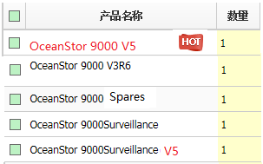
SCT、UniSTAR CFG
Select this version for new project non video surveillance scene
Select this version for extend project non video surveillance scene
Select this version for non-standard configuration
Select this version for extend project video surveillance scene
Select this version for new project video surveillance scene

Slide 7
Capacity Calculation
Other scenarios
Available capacity = Raw capacity x Usage rate x 0.9 x 0.909 (Optional)
Video input scenarios
Available capacity = Raw capacity x Usage rate x 95%(read-only waterline) x 94.5% (deducting the reserved space for the metadata) x 0.909 (Optional)
Video surveillance checkpoint images scenarios
Available capacity = Raw capacity x Usage rate x 94% (deducting the reserved space for the metadata) x 91.5% (deducting the reserved space for the file system) x 0.909 (optional, number system conversion)
Note: 1. If small-file aggregation container 2.0 is enabled in the checkpoint scenario, the maximum value of N (ODC) in N+M is 18 (≥ 64 GB) or 8 (< 64 GB). This value does not include storage semantics. If the system has storage semantics, add another 16 GB.
The +1 redundancy configuration is not recommended. If requirements on utilization are high, you are advised to use +2:1 redundancy configuration.
When querying C72 node utilization，the number of nodes in the following table should be equal to the number of C72 nodes x 2.
Disk utilization is determined by the redundancy ratio. For details, see the redundancy ratio table. The preceding formula does not take 10% of reserved file system space, and additional storage space for snapshot and remote replication into consideration
Notes:
1. Because the file system requires 10% reserved space, add 10% to the actual available capacity. 2. To consider binary and decimal disk capacity conversion, add 10% to the required available capacity. 3. Reserve additional space if snapshot, NDMP, remote replication, or other software functions need to be configured. 4. To avoid double-disk failure, you are recommended to configure a redundancy ratio of +2, +3, +4, +2:1, or +3:1.

Slide 8
Principles for Configuring Back-end Switches
Number of Nodes | 10GE Networking (New Site) | Configuration Description
3-40 | Huawei CE6855-48S6Q-HI | The configurator automatically completes configurations.
41-176 | Huawei CE12804S | Place orders from the Datacom Product line. Contact your datacom product manager to assist in configuration.
177-288 | Huawei CE12808S | Place orders from the Datacom Product line. Contact your datacom product manager to assist in configuration.
Number of Nodes | InfiniBand Networking (New Site) | Configuration Description
3-16 | MELLANOX MSX6018F-1BRS | The configurator automatically completes configurations.
17-32 | MELLANOX MSX6025F-1SFS | Require manual input. Contact your MO if necessary.
Interconnection and management switches are configured by default for OceanStor 9000 nodes in a back-end network. Switches and optical transceivers on the switches in a front-end network must be provided by customers.
Principles for configuring management switches CE5855: one switch for every 40 nodes
If you need to use switches of other brands or models, submit OR tickets to R&D personnel for verification in advance.

Slide 9
Networking of CE12800 Series Switch with Over 40 Nodes
Number of stacked network ports: N/2 x 10GE or N/8 x 40GE
N = Number of storage nodes
CE12800
CE12800
N x 10GE network ports
N x 10GE network ports
Storage node
Storage node
...
Storage node
Storage node
In the case of over 40 nodes, the configurator of the limited version can only provide configurations excluding CE12800 switches in internal networks. Field engineers must place orders from the Datacom Product Line separately.
The requirements on configuring CE12800 series switches are as follows:
Two switches are required and each is equipped with dual power supplies.
If two 10GE switches are stacked, then:
Number of 10GE optical transceivers for each switch = N + N/2
Number of Fibre Channels = N + N/4
If two 40GE switches are stacked, then:
Number of 10GE optical transceivers for each switch = N
Number of 40GE optical transceivers = N/8
Number of Fibre Channels = N + N/16
The model of optical transceivers that connect switches and nodes: Optical transceiver, SFP+, 850 nm, 10 Gbit/s, LC, MM, 0.3 km.

Slide 10
Configurations of Back-end 10GE Network Cables
Back-end 10GE network:
Optical fibers and optical transceivers are configured by default in a front-end 10GE network.
Twisted pair cables are configured by default in a front-end GE network (non-quotation item).
In a back-end 10GE network, nodes in the first cabinet are configured with 3-meter integrated cables (with optical transceivers at both ends) and nodes in other cabinets are configured with optical fibers and optical transceivers by default.
BOM Code | Description | Remarks
02318169 | Switch Products, LE0M0XSM88, Optical Transceiver, SFP+, 10G, Multi-mode Module(850nm, 0.3km, LC) | Optical transceivers shared by nodes and back-end 10GE switches
14130347 | Patch Cord, DLC/PC, DLC/PC, Multi-mode, 10m,A1b, 2mm | 10-meter optical fibers
14130354 | Patch Cord, DLC/PC, DLC/PC, Multi-mode, 30m,A1b, 2mm | 30-meter optical fibers
04050453 | High Speed Cable, Passive QSFP+ Cable, 1.0m, QSFP+ 38M, CC8P0.254B(S), QSFP+38M, For Indoor | 1-meter stacking cables used to stack two 10GE switches; when two switches are located in the same cabinet, configure: 3 to 16 nodes: 2 cables; 17 to 24 nodes: 3 cables; 24 or more: 4 cables
04050455 | High Speed Cable, Passive QSFP+ Cable, 5.0m,QSFP+ 38M, CC8P0.4B(S), QSFP+38M, For Indoor | 5-meter stacking cables used to stack two 10GE switches; when two switches are located in different cabinets, configure: 3 to 16 nodes: 2 cables; 17 to 24 nodes: 3 cables; 24 or more: 4 cables
04050185 | High Speed Cable, SFP+ High Speed Cable, 3m, SFP+20M, CC2P0.254B(S), SFP+20M, LSZH | 3-meter integrated cables and built-in optical transceivers

Slide 11
Configurations of Back-end InfiniBand Network Cables
Back-end InfiniBand network:
Optical fibers and optical modules are configured by default in a front-end 10GE network.
Twisted pair cables are configured by default in a front-end GE network (non-quotation item).
In a back-end InfiniBand network, 3-meter and 10-meter integrated InfiniBand cables with optical transceivers are configured by default. 3-meter cables are used to connect nodes in the first cabinet to switches, as well as for interconnection between switches.
BOM Code | Description | Remarks
04050694 | High Speed Cable, FDR High Speed Cable-56Gbps, 3m, QSFP+38M, CC8P0.32B(S), QSFP+38M, Indoor | Used to connect nodes in the first cabinet to switches, as well as for interconnection between switches; 2 cables for switch interconnection
02310VEL | Function Module, E6000, QSFP-14G-LCMM, IB FDR High-speed integrated optical module QSFP+(include 10M Cable)-56Gb/s | Used to connect nodes in the second cabinet to switches

Slide 12
Principles for Configuring Cabinets
42 U IT cabinets
Eight P36/C36 nodes, twelve P12/P25 nodes, or six C72 nodes in a cabinet
63 A PDUs for 6300 W power consumption or more
Power Consumption per Cabinet | Number of Nodes per Cabinet
≤ 6000 W | Six P36E/C36E nodes, nine P12E/P25E nodes, or four C72 nodes
6300 W ≤ Power consumption ≤ 8000 W | Eight P36E/C36E nodes, ten P12E/P25E nodes, or five C72 nodes
Power consumption ≥ 8000 W | Eight P36E/C36E nodes, twelve P12E/P25E nodes, or six C72 nodes

Slide 13
Contents
1
System Introduction
2
Product Configuration Guide (initial and expansion)
3
Service Configuration Guide
4
eDesigner Solution Configuration Guide

Slide 14
Configurations of OceanStor 9000 V300R006
Version | Node Type | Network Type | Memory Type | Disk
V300R006 | P25E node | 2 x 10GE front-end networks + 2 x 10GE back-end networks 2 x GE front-end networks + 2 x 10GE back-end networks 4 x GE front-end networks + 2 x 10GE back-end networks 2 x InfiniBand front-end networks + 2 x InfiniBand back-end networks 2 x 10GE front-end networks + 2 x InfiniBand back-end networks | 48 GB, 64 GB, 80 GB, 96GB, 160 GB | 600 GB SSD, 960 GB SSD, 600 GB SAS, 900 GB SAS, 1.2 TB SAS, 1.8 TB SAS
 | P36E node |  | 48 GB, 64 GB, 80 GB, 96GB, 160 GB | 600 GB SSD, 960 GB SSD, 2 TB/4 TB/6 TB/10 TB SATA, 2 TB/4 TB/6 TB NL-SAS
 | P12E node |  | 32 GB, 48 GB, 80 GB, 160 GB | 600 GB SSD, 400 GB SSD, 2 TB/4 TB/6 TB/10 TB SATA, 2 TB/4 TB/6 TB NL-SAS
 | C36E node | 2 x 10GE front-end networks + 2 x 10GE back-end networks 2 x GE front-end networks + 2 x 10GE back-end networks 4 x GE front-end networks + 2 x 10GE back-end networks | 32 GB, 48 GB | 2 TB/4 TB/6 TB/10 TB SATA and 2 TB/4 TB/6 TB NL-SAS
 | C72 node | 8 x GE front-end networks + 4 x 10GE back-end networks | 64 GB | 2 TB/4 TB/6 TB/10 TB SATA
Note:
A system must accommodate at least three nodes of the same type. if a system is configured with file and object interfaces, at least three nodes for file interfaces and two nodes for object interfaces are required.

Slide 15
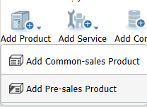
Configurations of OceanStor 9000 White Box
Version | Node Type | Network Type | Memory Type | Disk
White box | C36E node、P12E node | 2 x GE front-end networks + 2 x 10GE back-end networks 4 x GE front-end networks + 2 x 10GE back-end networks 6 x GE front-end networks + 2 x 10GE back-end networks 8 x GE front-end networks + 2 x 10GE back-end networks 2 x 10GE front-end networks + 2 x 10GE back-end networks 4 x 10GE front-end networks + 2 x 10GE back-end networks 2 x GE networks + 6 x 10GE front-end networks + 2 x 10GE back-end networks 4 x GE networks + 4 x 10GE front-end networks + 2 x 10GE back-end networks 2 x GE networks + 4 x 10GE front-end networks + 2 x 10GE back-end networks 6 x GE networks + 2 x 10GE front-end networks + 2 x 10GE back-end networks 4 x GE networks + 2 x 10GE front-end networks + 2 x 10GE back-end networks 2 x GE networks + 2 x 10GE front-end networks + 2 x 10GE back-end networks | 32 GB, 48 GB, 80 GB, 96 GB | 2 TB/4 TB/6 TB/10 TB SATA and 2 TB/4 TB/6 TB NL-SAS
White box version: On SCT, choose My Quotations > New > Add Product > Add Pre-sales Product > OceanStor 9000 (White box).
Note:
A system must accommodate at least three nodes of the same type.
There are only ESS configurator permissions for the white box version.

Slide 16
Factors Affecting OceanStor 9000 Quotation
Parameter description
1000 instead of 1024 is used in capacity conversion.
10GE back-end networks can support more than 40 nodes. If the number of nodes exceeds 40, the generated order does not contain 10GE switches required for OceanStor 9000 internal networks and must be placed separately from the Datacom Product Line.
An InfiniBand network can only be configured with a maximum of 16 nodes.
10GE front-end and back-end networks are highly recommended for OceanStor 9000.
The load balancing software is a piece of free software contained in a basic software package. InfoRevive is only configured in video surveillance scenarios and prohibited in other scenarios.
The C72 node is applied to video recording scenarios and cannot be equipped with remote replication software and quota management software.
Storage units
P25E node
P36E node
P12E node
C36E node
C72E node
System software and licenses
for value-added software
Other components
Switch unit
Cabinet/PDU
KVM
Cable
Services
IP product maintenance
Software support
Hardware warranty/Warranty
renewal
Professional services

Slide 17
Details on Configurations – Requirement
Configuration example:
Initial capacity requirements:
Available capacity of a file system is 800 TB (SAS disk 40 TB, SATA disk 760 TB). The redundancy ratio is +2. P25E nodes are equipped with SAS disks (900 GB) and P36E nodes are equipped with SATA disks (6 TB).
Software requirements: quota management software, load balancing software, and storage tiering software
Accessories: including cabinets, KVM, and SMS modems
Capacity expansion requirements:
60 TB more SAS capacity and 210 TB more SATA capacity in the file system
Link for logging into the SCT: http://app.huawei.com/unistar/sct/login!loginChoose.action

Slide 18
Details on Configurations – SCT Initial Setup 1
1. Select application scenarios and network types.
The "In the video surveillance scenario or not?" option is added. Capacity is calculated differently in video surveillance scenarios.
2. Select node types and redundancy ratios.

Slide 19
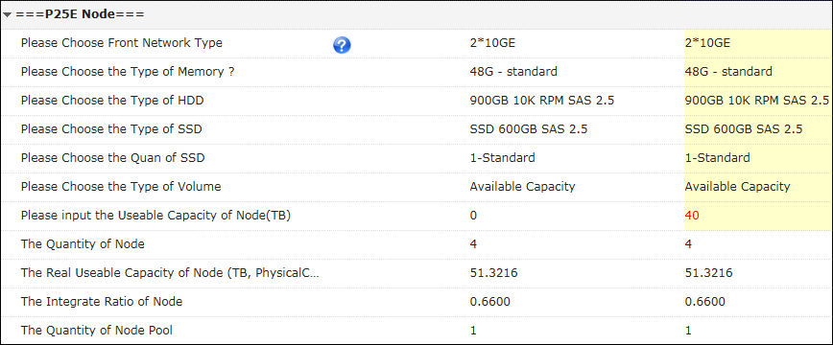
Details on Configurations – SCT Initial Setup 2
3. Configure nodes.
In this example, the available capacity is 800 TB (SAS disk 40 TB, SATA disk 760 TB). The redundancy ratio is +2. P25 nodes are equipped with SAS disks (900 GB) and P36 nodes are equipped with SATA disks (6 TB).
The disk type and quantity of SSDs can be changed (four SSDs at most). In this case, one 400 GB SSD and 24 900 GB SAS disks are configured.
Input the SAS available capacity.
These parameters are calculated automatically. Node pool allocation and utilization are displayed.

Slide 20
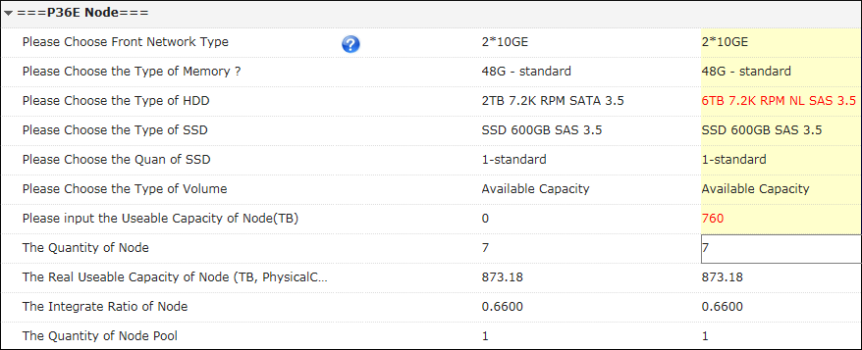
Details on Configurations – SCT Initial Setup 3
4. You can select 6 TB SATA disks based on requirements and input the available capacity.
The disk type on a single node can be changed. By default, the quantity of SSDs is one and cannot be changed. In this case, one 400 GB SSD and 35 6 TB SATA disks are configured.
Input the SATA available capacity.
These parameters are calculated automatically. Node pool allocation and utilization are displayed.

Slide 21
Details on Configurations – SCT Initial Setup 4
Front-end optical fibers can be 10 meters long, 30 meters long, or prepared by the customer.
5. Configure auxiliary devices.

Slide 22
Details on Configurations – SCT Initial Setup 5
6. Configure software functions.
If there are file nodes and object nodes, the preceding value-added features can only be configured on file nodes. The number of licenses is equal to that of file nodes.

Slide 23
Details on Configurations – SCT Initial Setup 6
6. Use dynamic configuration to generate official code.
In V3R5 or later, the OceanStor 9000 configuration package uses dynamic configuration. After the configuration, perform the following steps to generate instance code. On SCT, choose Config Result > More > Instantiation.

Slide 24
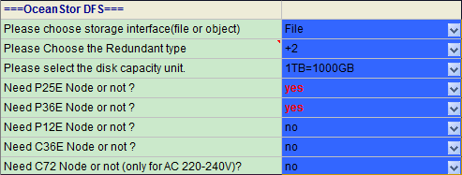
Details on Configurations – UniSTAR CFG Initial Setup 1
1. Select application scenarios and network types.
2. Select node types and redundancy ratios.

Slide 25
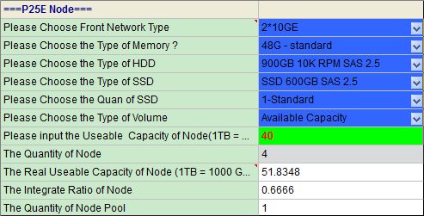
Details on Configurations – UniSTAR CFG Initial Setup 2
3. Configure nodes.
In this example, the available capacity is 800 TB (SAS disk 40 TB, SATA disk 760 TB). The redundancy ratio is +2. P25 nodes are equipped with SAS disks (900 GB) and P36 nodes are equipped with SATA disks (6 TB).
The disk type and quantity of SSDs can be changed (four SSDs at most). In this case, one 400 GB SSD and 24 900 GB SAS disks are configured.
Input the SAS available capacity.
These parameters are calculated automatically. Node pool allocation and utilization are displayed.

Slide 26
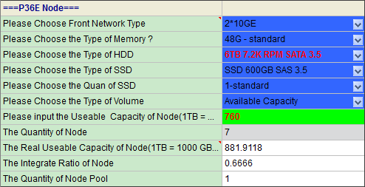
Details on Configurations – UniSTAR CFG Initial Setup 3
4. You can select 6 TB SATA disks based on requirements and input the available capacity.
The disk type on a single node can be changed. By default, the quantity of SSDs is one and cannot be changed. In this case, one 400 GB SSD and 35 6 TB SATA disks are configured.
Input the SATA available capacity.
These parameters are calculated automatically. Node pool allocation and utilization are displayed.

Slide 27
Details on Configurations – UniSTAR CFG Initial Setup 4
5. Configure auxiliary devices.
Front-end optical fibers can be 10 meters long, 30 meters long, or prepared by the customer.
6. Configure software functions.
If there are file nodes and object nodes, the preceding value-added features can only be configured on file nodes. The number of licenses is equal to that of file nodes.

Slide 28
Details on Configurations – UniSTAR CFG Initial Setup 5
6. Use dynamic configuration to generate official code.
In V300R005 or later, the OceanStor 9000 configuration package uses dynamic configuration. After the configuration, perform the following steps to generate instance code.
The red “C” indicates that the part number is a virtual code. You need click ‘output quotation’to generate a instance code.
The green “C” indicates that the part number is real instance code.

Slide 29
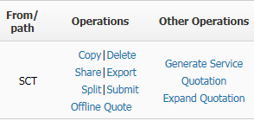
Details on Configurations – SCT Expansion Setup
不要使用工具自带的扩容功能
1
Select expand project
Select live network version
2
Select live network software/hardware
3
Select expansion software/hardware
4

Slide 30
Details on Configurations – SCT Expansion Setup 1
1. Select a expand project.
2. Select a product version.

Slide 31
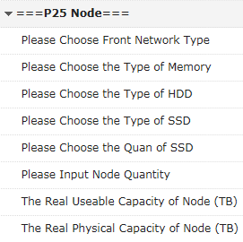
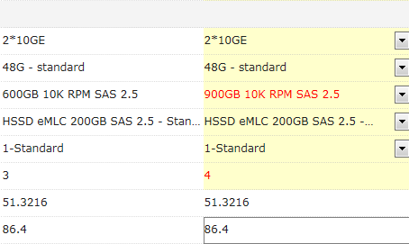
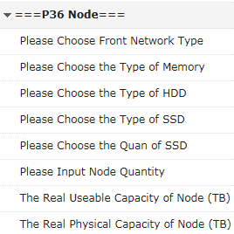
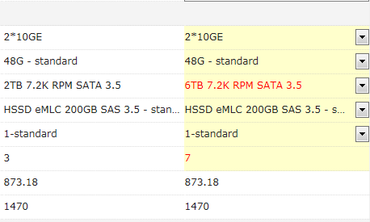
Details on Configurations – SCT Expansion Setup 2
3. Configure hardware information on the live network.

Slide 32
Details on Configurations – SCT Expansion Setup 3
4. Configure software information on the live network.

Slide 33
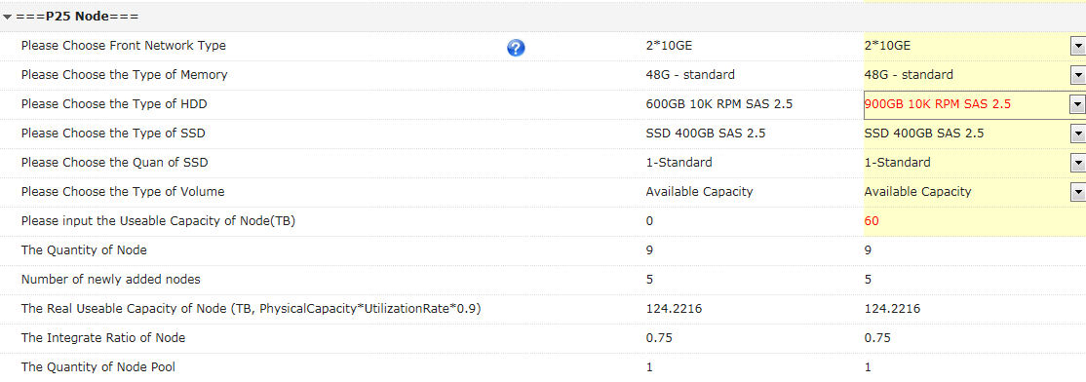
Details on Configurations – SCT Expansion Setup 4
5. Configure the capacity expansion nodes.
If the configurations are the same as original nodes, perform the expansion in the original node pool; otherwise, perform the expansion in a new node pool and add at least three nodes.

Slide 34
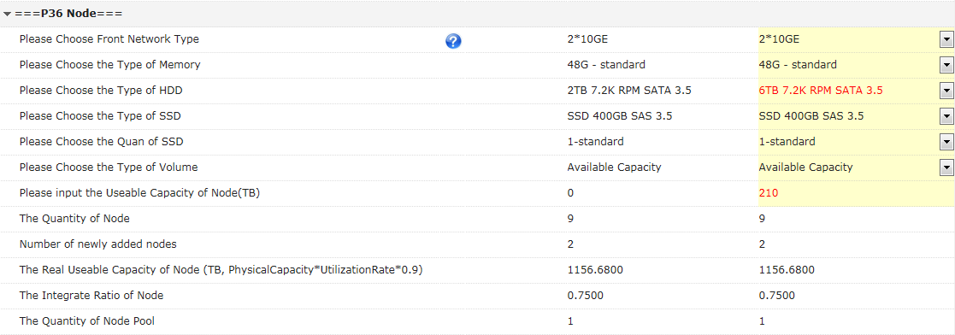
Details on Configurations – SCT Expansion Setup 5

Slide 35
Details on Configurations – SCT Expansion Setup 6
6. Select the mapping devices and value-added software.
1. If these value-added features have been configured for the original system, enable these features for the new nodes during capacity expansion.
In this example, the InfoAllocator and InfoTier functions are enabled for the new nodes by default.
2. If a feature has not been enabled on the live network but needs to be enabled on new nodes, the number of licenses is the number of original nodes plus that of new nodes

Slide 36
Details on Configurations – UniSTAR CFG Expansion Setup 1
Note: Does not support the use of V300R006 hardware expansion in the V100R001 and V300R005 versions.
1. Set V300R005.
2. Select a product version.

Slide 37
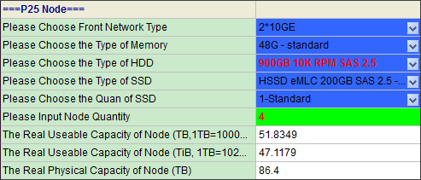
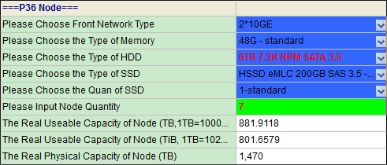
Details on Configurations – UniSTAR CFG Expansion Setup 2
3. Configure hardware information on the live network.

Slide 38
Details on Configurations – UniSTAR CFG Expansion Setup 3
4. Configure software information on the live network.

Slide 39
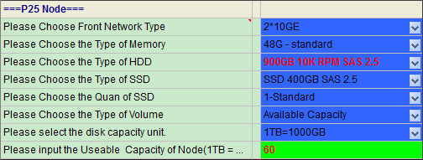
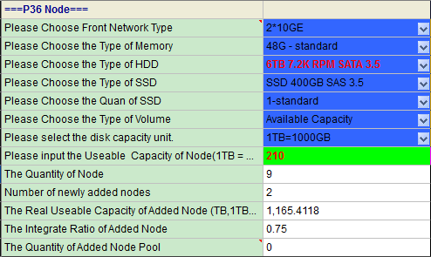
Details on Configurations – UniSTAR CFG Expansion Setup 4
5. Configure the capacity expansion nodes.
If the configurations are the same as original nodes, perform the expansion in the original node pool; otherwise, perform the expansion in a new node pool and add at least three nodes.

Slide 40
Details on Configurations – UniSTAR CFG Expansion Setup 5
6. Select the mapping devices and value-added software.
1. If these value-added features have been configured for the original system, enable these features for the new nodes during capacity expansion.
In this example, the InfoAllocator and InfoTier functions are enabled for the new nodes by default.
2. If a feature has not been enabled on the live network but needs to be enabled on new nodes, the number of licenses is the number of original nodes plus that of new nodes

Slide 41
Contents
1
System Introduction
2
Product Configuration Guide (initial and expansion)
3
Service Configuration Guide
4
eDesigner Solution Configuration Guide

Slide 42
Principles for Configuring Maintenance Services
OceanStor 9000 service configurations include:
Mandatory option: implementing services
Mandatory option: product support services (including software support, IP product support, in-warranty upgrade of nodes, and warranty extension)
Mandatory option: other professional services
Three-year Hi-Care Onsite Standard 9x5xNBD Service is provided by default for OceanStor 9000 hardware nodes (without software support services).
Duration of software support services must be configured for at least three years.

Slide 43
Configuration Guide for Maintenance Services — IP Product Support Services
Take three-year Hi-Care Onsite Standard 9x5xNBD Service as an example:
1. Select maintenance and installation services.
2. Configure maintenance services for hardware nodes.

Slide 44
Configuration Guide for Maintenance Services – Hardware Maintenance
3. Select software support services.
Software support services are sold together with other services and do not have the service level. Its service duration is three years by default.

Slide 45
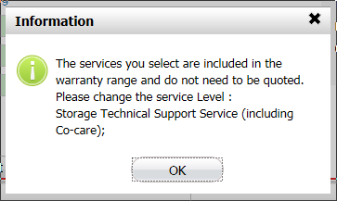
Configuration Guide for Maintenance Services – Software Support Services
4. Configure hardware technical support services.
Since three-year Hi-Care Onsite Standard 9x5xNBD Service is configured by default for OceanStor 9000 hardware nodes in some regions, information on the left is displayed when you set Level to Hi-Care Onsite Standard 9x5xNBD Service.
When Level is set to Hi-Care Onsite Standard 9x5xNBD Service, Duration (Year(s)) can be 0, 4, and 5.

Slide 46
Configuration Guide for Maintenance Services – Hardware Maintenance
5. Install services.
After you confirm service installation, configurations are performed automatically.

Slide 47
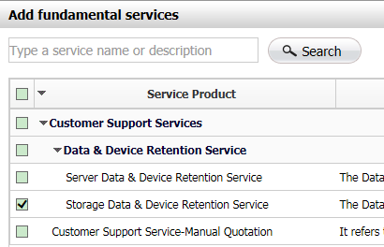
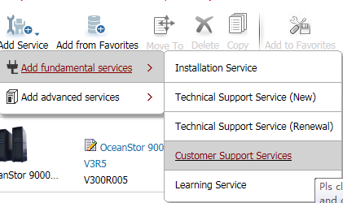
Configuration Guide for Maintenance Services – Media Retention Services (1)
6. Configure media retention services.
On the configuration page, click Add Service.
Step 1
Step 3
Step 2

Slide 48
Configuration Guide for Maintenance Services – Media Retention Services (2)
Step 4 Input the service duration.
Step 5 Input disk quantity.

Slide 49
Contents
1
System Introduction
2
Product Configuration Guide (initial and expansion)
3
Service Configuration Guide
4
eDesigner Solution Configuration Guide

Slide 50
eDesigner Solution Configuration
This is an OceanStor 9000 portal. You can select a product before choosing a scenario.

Slide 51
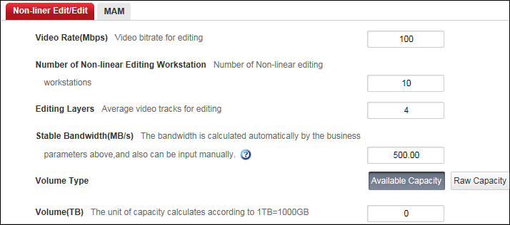
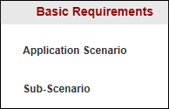
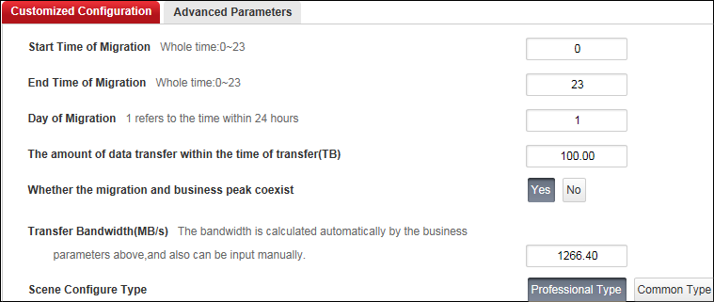
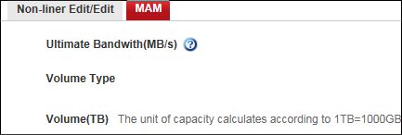
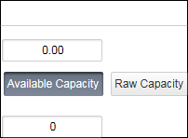
Details on Configurations – 1
The following describes how to configure eDesigner in a media asset scenario.
1. Input requirements in a media asset scenario.
Step 1: Select a sub-scenario from MAM, non-linear edit/edit, and non-linear edit/edit + MAM.
Step 3: Input specific capacity and performance needs.
Step 2: Input customized requirement parameters.
Professional Type indicates that detailed field network conditions and requirements are well understood. Common Type means that only capacity and performance demands are aware of.

Slide 52
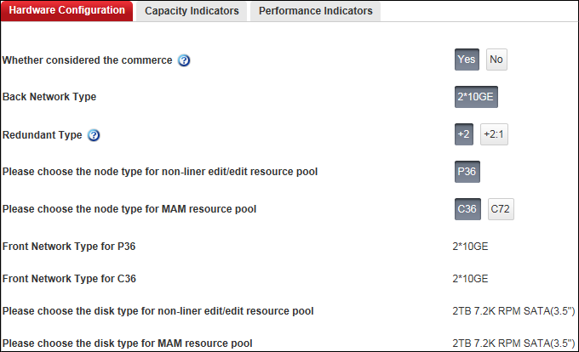
Details on Configurations – 2
2. Plan capacity in the media asset scenario.
Adjust product hardware configurations.

Slide 53
Details on Configurations – 3
3. Select device types in the media asset scenario.
Select auxiliary equipment and value-added software.

Slide 54
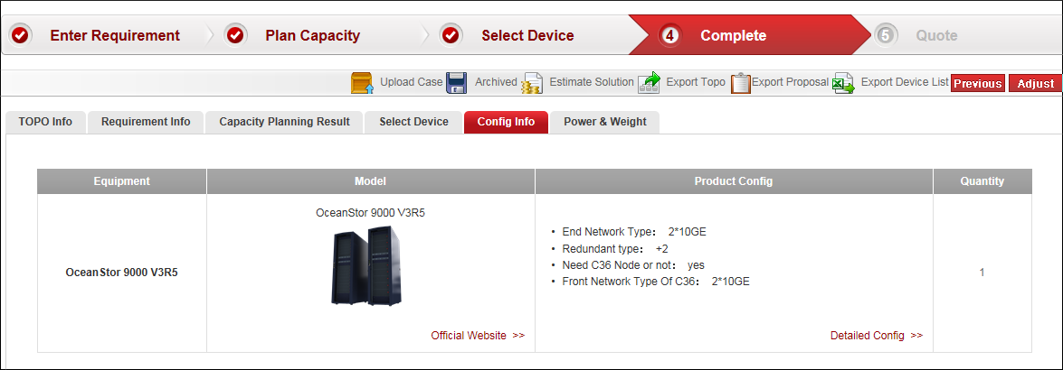
Details on Configurations – 4
4. Complete the solution design and export the BOQ.
Interconnect with SCT and generate the BOQ.
Export the static network topology.
Generate the solution design report.

