Slide 1
Huawei OceanStor 2600 V3 for Video and OceanStor 2800 V5 Storage Systems Quotation Guide

Slide 2
Contents
1
Product Positioning and Overview
2
OceanStor 2600 V3 for Video Quotation Guide
3
OceanStor 2800 V5 Quotation Guide

Slide 3
Overview of OceanStor 2600 V3 for Video and OceanStor 2800 V5
OceanStor 2600 V3 for Video
OceanStor 2800 V5
Oriented to video surveillance storage in branches, with support for SAN & NAS convergence
Dual controllers
16 GB cache and two hot-pluggable expansion modules per controller
A maximum of 396 disks
16 Gbit/s Fibre Channel, 10GE, SAS 3.0, and PCIe 3.0
Support for SSDs, SAS disks, and SATA disks
SmartConfig deploys video surveillance storage with merely 3 steps in 1 minute, greatly improving deployment efficiency.
Oriented to video cloud storage and direct stream storage appliances in branches, with support for direct stream storage as well as stream forwarding and storage
32 GB or 64 GB cache and two hot-pluggable expansion modules per controller
A maximum of 750 disks
10GE, SAS 3.0, and PCIe 3.0
Support for SSDs, SAS disks, and SATA disks
The 32 GB cache edition supports SAN & NAS convergence, and the 64 GB cache edition supports direct stream storage.

Slide 4
Specifications of OceanStor 2600 V3 for Video
Product Name | OceanStor 2600 V3 for Video
Hardware Specifications
Max. number of disks | 396
Max. number of controllers | 2
Cache size | 32 GB
Max. number of front-end ports | 24
Video performance | A maximum of 512-channel 4 Mbit/s IP SAN access and 256-channel 4 Mbit/s NAS access
Software Specifications
Access protocol | SAN & NAS convergence, with support for 8 or 16 Gbit/s FC SAN, GE or 10GE IP SAN, and GE or 10GE NAS
Value-added software | SmartThin, HyperSnap, and HyperReplication
Ease of Deployment
Easy-to-deploy architecture | The compact architecture enables a smaller size, lower noise, and lower power consumption. So the deployment is less demanding of the environment, even not requiring an equipment room.
Easy configuration | The SmartConfig tool allows storage configuration to be completed with merely three simple steps in 1 minute. IT administrators can quickly learn how to configure the system, without the need to master complicated storage technologies.

Slide 5
Specifications of OceanStor 2800 V5
Product Name | OceanStor 2800 V5 Stream Forwarding and Storage |  | OceanStor 2800 V5 Direct Stream Storage
Hardware Specifications
Max. number of disks | 750 |  | 750
Max. number of controllers | 2 |  | 2
Cache size | 64 GB |  | 128 GB
Max. number of front-end ports | 24 |  | 24
Video performance | A maximum of 1600-channel 4 Mbit/s IP SAN access and 512-channel 4 Mbit/s NAS access |  | A maximum of 400-channel 4 Mbit/s IP SAN storage
Supported disk type | SSD/SAS/SATA |  | SAS/SATA
Software Specifications
Access protocol | SAN & NAS convergence, with support for GE or 10GE IP SAN and GE or 10GE NAS |  | VM access
Value-added software | SmartThin, HyperSnap, and HyperReplication |  | SmartThin, HyperSnap, and HyperReplication

Slide 6
Differences Between OceanStor 2600 V3 for Video and OceanStor 2800 V5
Product Name | OceanStor 2600 V3 for Video | OceanStor 2800 V5
Hardware Specifications
Max. number of disks | 396 | 750
Cache size | 32 GB | 64 GB or 128 GB
Host port type | 8/16 Gbit/s Fibre Channel | FC SAN is not supported.
Built-in VMs | Not supported | The 128 GB cache edition supports six VMs.
SAN & NAS convergence | Supported | The 128 GB cache edition does not support SAN & NAS convergence.
Performance | A maximum of 512 channels at 4 Mbit/s | A maximum of 1600 channels at 4 Mbit/s

Slide 7
Contents
1
Product Positioning and Overview
2
OceanStor 2600 V3 for Video Quotation Guide
3
OceanStor 2800 V5 Quotation Guide

Slide 8
Quotation Elements About OceanStor 2600 V3 for Video
Application mode
SAN/NAS video or lightweight video cloud
Storage unit
Disk unit (SSD, SAS, and/or NL-SAS)
Storage unit
Disk enclosure (standard enclosure and/or high-density enclosure)
Value-added storage software
Value-added software
Value-added software upgrade service
Service
Installation and maintenance
Component

Slide 9
Process for Configuring OceanStor 2600 V3 for Video
Access the SCT: http://unistar.huawei.com/sct/login!loginChoose.action
Select a product model.
Select OceanStor 2600 V3.
Select an application mode.
Application mode
(Optional) Select front-end expansion I/O modules.
Select disk types and quantities.
Select disk enclosure types and quantities.
FC cables
Select value-added software.
Select detailed specifications.
Select disk types and quantities.
Note:
1. The items in red are optional, and those in black are mandatory.
2. Front-end expansion interface modules must be configured in pairs. A maximum of two pairs can be configured.
Select hardware maintenance.

Slide 10
Precautions on Installation Materials
Optical transceivers:
10GE optical interface modules are equipped with multi-mode optical transceivers by default and do not need additional configuration.
SAS cables:
Typically, each standard disk enclosure is configured with two 1-meter SAS cables by default. High-density disk enclosures are not configured with any SAS cable and need a separate configuration.
Standard disk enclosures: If all enclosures are deployed next to each other in the same cabinet, one 3-meter SAS cable must be purchased in the event that three or more disk enclosures (including new deployment and expansion) are connected to the controller enclosure, and three 3-meter SAS cables must be purchased in the event that six or more disk enclosures are connected to the controller enclosure.
High-density disk enclosures: Each enclosure consumes 1.2 meters of a SAS cable. If the distance between two enclosures does not exceed 3 U, four 3-meter cables must be configured. If the distance exceeds 3 U or the enclosures reside in different cabinets, four 5-meter cables must be configured.
Notes:
Regarding installation materials, pay attention to the following:
1. To meet the IT product line's configuration streamlining requirement, the major cables and accessories used in a cabinet act as quotation items, thereby ensuring delivery quality.
2. Filler panels on a disk unit are non-quotation items. They are configured for vacant slots by default.
3. I/O module filler panels are non-quotation items. They are configured for vacant slots by default.

Slide 11
Configuration Example 1
Requirements:
One OceanStor 2600 V3
Video storage scenario, where the storage system provides both video and image storage
SAN+NAS, providing eight 10 Gbit/s ports
6 x 600 GB SAS disks for image storage; 144 x 6 TB disks for video storage
Snapshot

Slide 12
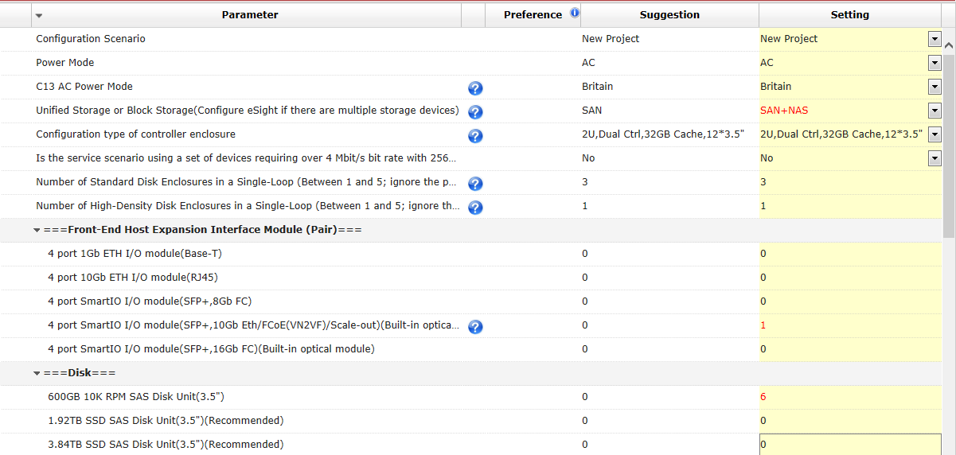
Configuration Process
Select SAN+NAS.
Interface module
Disks for image storage
Disks for video storage

Slide 13
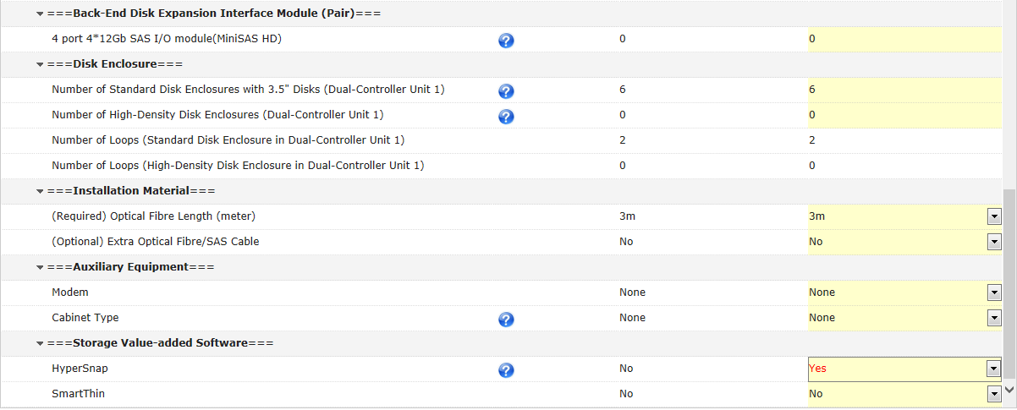
Configuration Process
The system automatically calculates six standard enclosures.
Select the length of the cable connected to a host.
Select snapshot.

Slide 14
Contents
1
Product Positioning and Overview
2
2
OceanStor 2600 V3 for Video Quotation Guide
3
OceanStor 2800 V5 Quotation Guide

Slide 15
OceanStor 2800 V5 Quotation Elements
Application scenario selection
Direct stream storage (128 GB), video storage (64 GB), or video cloud (64 GB)
128 GB cache
64 GB cache
Whether additional four 600 GB SAS disks are needed to install VMs
Select SAN+NAS or SAN.
Select video storage or lightweight video cloud.
Disk unit (SSD, SAS, and/or NL-SAS) + disk enclosure
Storage value-added software + software upgrade service
Installation and maintenance

Slide 16
OceanStor 2800 V5 Quotation Elements
Access the SCT: http://unistar.huawei.com/sct/login!loginChoose.action
Select a product model.
Select OceanStor 2800 V5.
Select controller enclosure specifications.
Cache specification
Video surveillance mode
(Optional) Select front-end expansion I/O modules.
Select disk types and quantities.
Select disk enclosure types and quantities.
Select value-added software.
Select a video surveillance mode.
Select disk types and quantities.
Note:
1. The items in red are optional, and those in black are mandatory.
2. Front-end expansion interface modules must be configured in pairs. A maximum of two pairs can be configured.
3. Both video storage and lightweight video cloud storage support the SAN+NAS mode. SATA disks must be configured for video storage.
4. The software must be configured with the Hi-Care application software upgrade support service.
Select hardware maintenance.

Slide 17
Precautions on Installation Materials
Optical transceivers:
10GE optical interface modules are equipped with multi-mode optical transceivers by default and do not need additional configuration.
SAS cables:
Typically, each standard disk enclosure is configured with two 1-meter SAS cables by default. High-density disk enclosures are not configured with any SAS cable and need a separate configuration.
Standard disk enclosures: If all enclosures are deployed next to each other in the same cabinet, one 3-meter SAS cable must be purchased in the event that three or more disk enclosures (including new deployment and expansion) are connected to the controller enclosure, and three 3-meter SAS cables must be purchased in the event that six or more disk enclosures are connected to the controller enclosure.
High-density disk enclosures: Each enclosure consumes 1.2 meters of a SAS cable. If the distance between two enclosures does not exceed 3 U, four 3-meter cables must be configured. If the distance exceeds 3 U or the enclosures reside in different cabinets, four 5-meter cables must be configured.

Slide 18
Configuration Example 1
Requirements:
One OceanStor 2800 V5
Direct stream storage, with six built-in VMs, each of which is configured with 50 GB system disk capacity
Eight front-end 10 Gbit/s ports
288 x 10 TB high-density disks
Snapshot

Slide 19
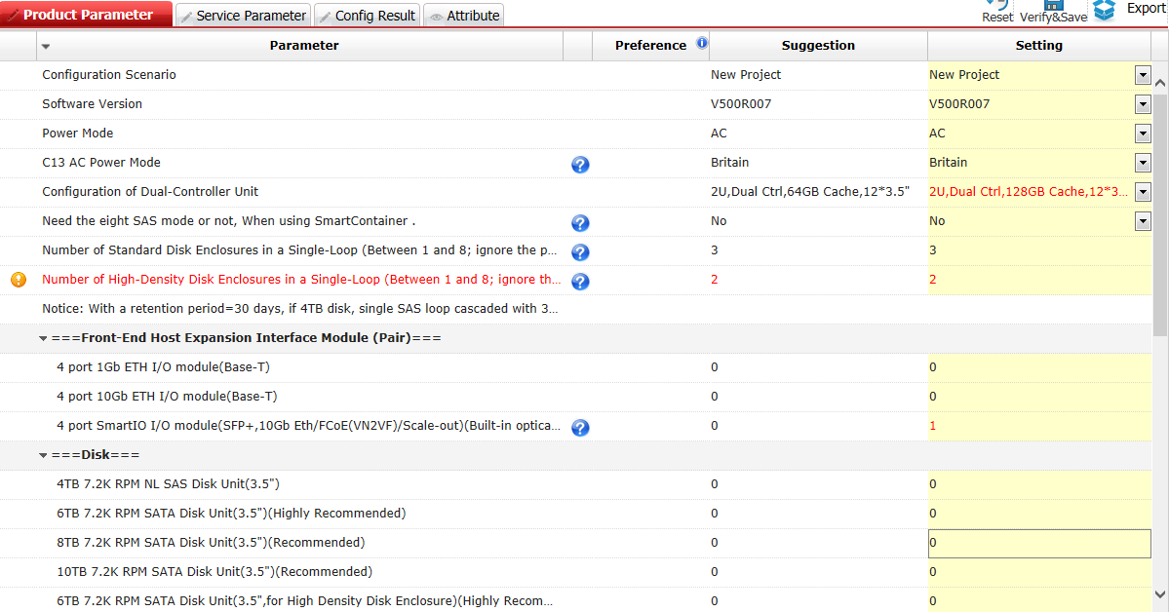
Configuration Process
Select 128 GB cache.
Four 600 GB disks in the controller enclosure meet VM system needs. The 8-disk mode is not necessary.
8 x 10 Gbit/s ports
288 x 10 TB disks

Slide 20
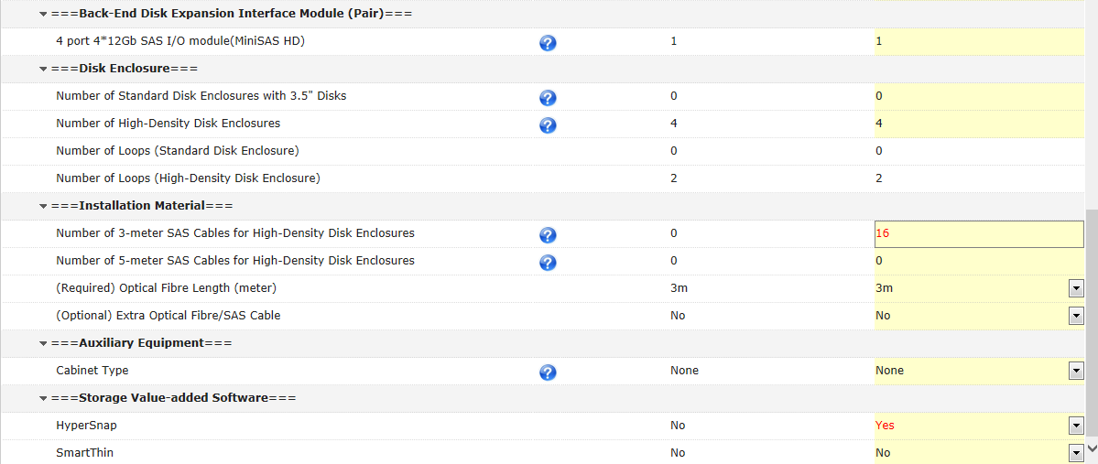
Configuration Process
The tool automatically calculates the number. Four high-density enclosures and four loops are needed. Therefore, one pair of interface modules needs to be added.
16 cables are required for four high-density enclosures in one cabinet.
Select snapshot.

Slide 21
Configuration Example 2
Requirements:
One OceanStor 2800 V5
Lightweight video cloud scenario, where the storage system provides both virtualization and video storage
SAN+NAS, providing eight 10 Gbit/s ports
8 x 600 GB SAS disks acting as VM system disks, and 144 x 6 TB disks used for video storage
Snapshot

Slide 22
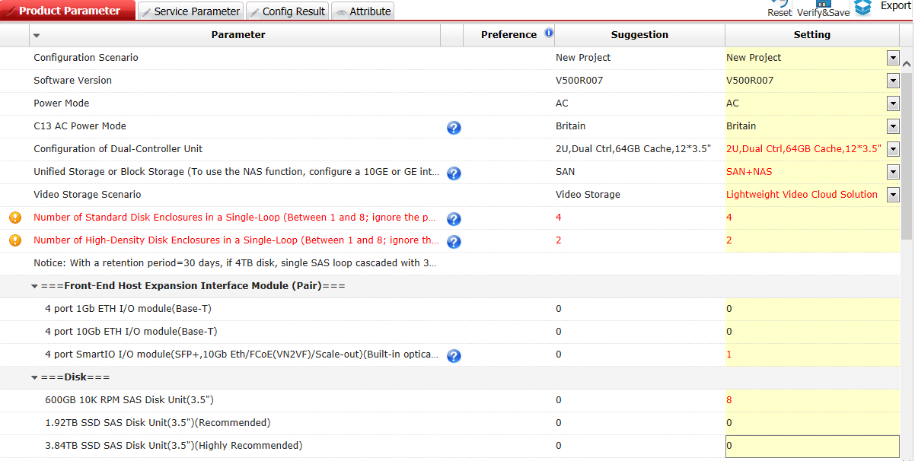
Configuration Process
Select 64 GB cache.
Select SAN+NAS.
Select the lightweight video cloud.
Interface module
Virtualization system disk
Video capacity disk

Slide 23
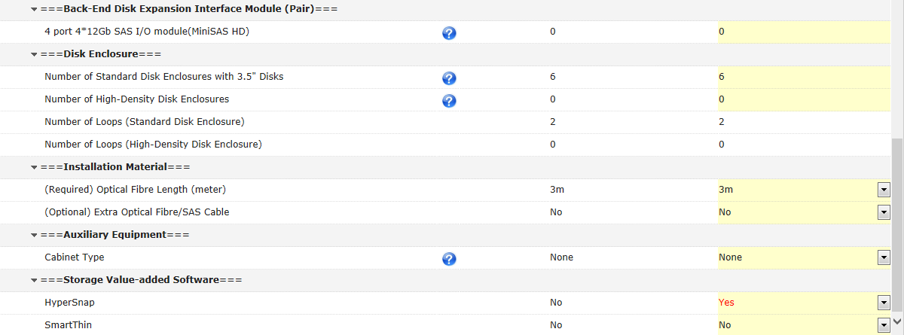
Configuration Process
The system automatically calculates six standard enclosures.
Select the length of the cable connected to a host.
Select snapshot.

Slide 24
Thank you
www.huawei.com
Copyright © Huawei Technologies Co., Ltd. 2015. All rights reserved.
All logos and images displayed in this document are the sole property of their respective copyright holders. No endorsement, partnership, or affiliation is suggested or implied. The information in this document may contain predictive statements including, without limitation, statements regarding the future financial and operating results, future product portfolio, new technology, etc. There are a number of factors that could cause actual results and developments to differ materially from those expressed or implied in the predictive statements. Therefore, such information is provided for reference purpose only and constitutes neither an offer nor an acceptance. Huawei may change the information at any time without notice.

