Slide 1
Huawei OceanStor 2200 V3 and 2600 V3 Storage Systems Quotation Guide

Slide 2
OceanStor 2200 V3 Entry-level Storage Product Hardware (Appearance)
SAS cascade ports
Tow SAS ports on each controller
Filler panel
Fan built in the power-BBU module
1+1 redundancy
94% conversion rate
Support for AC and 240 V DC
Interface module
1 hot-pluggable IO module slot, only for the frontend
Interface types: GE, 10GE electrical, SmartIO card (16G FC, 8G FC, 10Gb FCoE [VN2VF], and 10Gb Eth [optical])
On-board ports
4xGE ports on each controller

Slide 3
OceanStor 2600 V3 Entry-level Storage Product Hardware (Appearance)
SAS cascade ports
Tow SAS ports on each controller
Interface module
2 hot-pluggable IO module slots, only for the frontend
Interface types: 8Gb FC, GE, 10GE electrical, SmartIO card (16G FC, 8G FC, 10Gb FCoE [VN2VF], 10Gb Eth [optical])
Fan built in the power-BBU module
1+1 redundancy
94% conversion rate
Support for AC and 48/240 V DC
On-board ports
4xGE ports on each controller

Slide 4
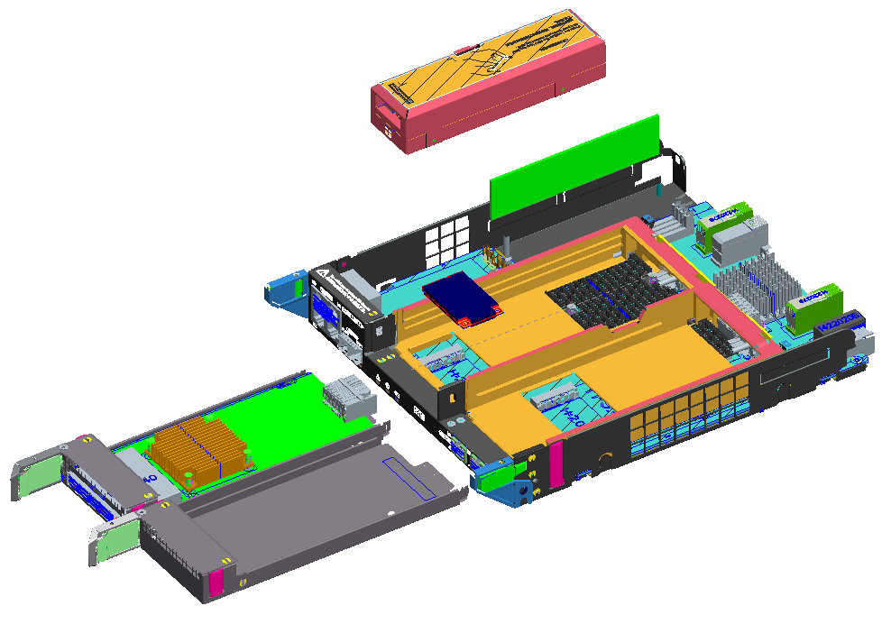
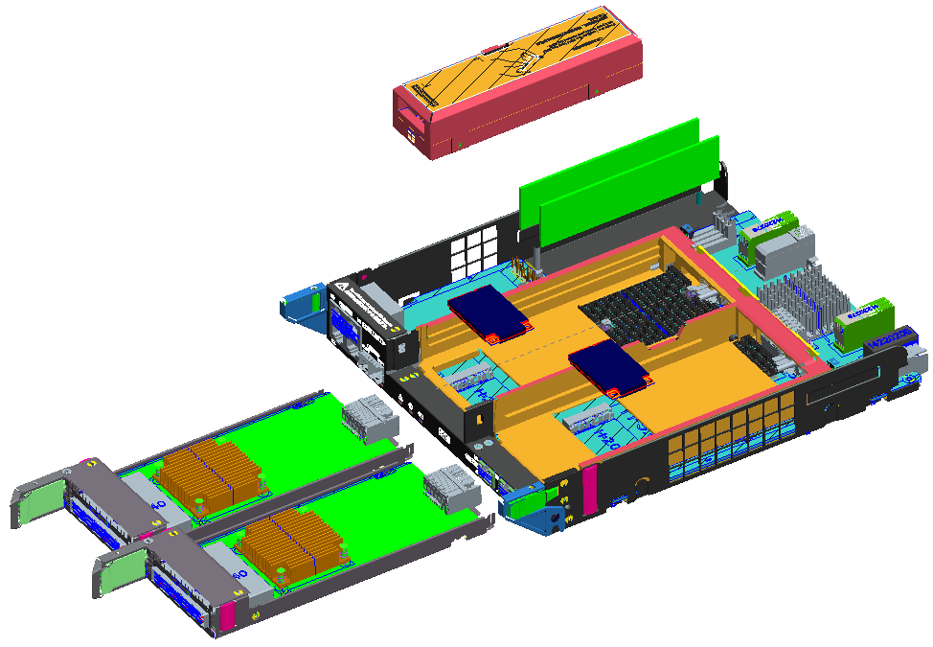
OceanStor V3 Entry-level Storage Controller Hardware (Internal)
2200 V3
CBU
2600 V3
CBU
DIMM0
DIMM0
DIMM1
msata0
msata0
Interface card 0
Interface card 0
msata1
Filler panel
Interface card 1
Differences between 2600 and 2200:
2200 has one memory while 2600 has two.
2200 has one MSATA low-rate disk while 2600 has two high-rate disks.
2200 has one interface card while 2600 has two.

Slide 5
OceanStor V3 Entry-level Storage System Specifications
Product | 2200 V3 | 2600 V3
Hardware Specifications
Maximum number of disks | 300 | 500
Maximum number of controllers | 2 | 8
Cache size (two controllers) | 16 GB/32 GB | 32 GB/64 GB
Maximum number of frontend host ports (two controllers) | 24 | 40
Software Specifications
Data protection software | HyperCopy, HyperClone, HyperMirror, HyperSnap, HyperReplication | HyperSnap, HyperCopy, HyperClone, HyperMirror, HyperReplication, HyperLock (WORM), HyperMetro, HyperVault
Critical service protection | SmartQoS | SmartQoS, SmartPartition
Resource utilization improvement | SmartTier, SmartCache, SmartThin, SmartMotion, SmartMigration, SmartErase, SmartVirtualization | SmartTier, SmartCache, SmartThin, SmartMotion, SmartMigration, SmartErase, SmartVirtualization, SmartMulti-Tenant, SmartCompression, SmartDedupe, SmartQuota
Easy configuration | SmartConfig greatly simplifies configurations for IT administrators. They can learn the configuration methods after brief introduction, and do not need to learn professional storage technologies.

Slide 6
Major Differences Among 2200 V3, S2600T V2, and S2200T V1
Key Feature | 2200 V3 | S2600T V2 (SAN) | S2200T V1
Hardware form | 2U disk and controller integration (3.5-inch 12 disk slots, 2.5-inch 25 disk slots) | 2U disk and controller integration (3.5-inch 12 disk slots) | 2U disk and controller integration (3.5-inch 12 disk slots, 2.5-inch 24 disk slots)
Types and number of controller ports | 4xGE service ports + 2xGE management ports (can be configured as service ports) | 4xGE service ports + 2xGE management ports (either port can be configured as a service port) | 3.5-inch disk controller: 4xGE service ports + 2xGE management ports (either port can be configured as a service port) 2.5-inch disk controller: 4xFC service ports + 2xGE management ports (either port can be configured as a service port)
System cache (two controllers) | 16 GB/32GB | 16 GB | 4 GB/8 GB/16 GB
Interface type | GE, 8G FC, 16G FC, 10GE/FCOE | GE, 8G FC, 16G FC, 10GE | GE, 8G FC, 10GE
Hyper software series | HyperSnap, HyperCopy, HyperReplication, HyperClone, HyperMirror | HyperSnap, HyperCopy, HyperReplication, HyperClone, HyperMirror | HyperSnap(HyperImage), HyperCopy, HyperReplication(HyperMirror)
Smart software series | SmartThin, SmartCache, SmartQoS, SmartTier, SmartMotion, SmartMigration, SmartErase, SmartVirtualization | SmartThin, SmartCache, SmartQoS, SmartTier, SmartMotion, SmartMigration, SmartErase, SmartVirtualization, SmartPartition, SmartMulti-Tenant, Data Reduction | SmartThin(HyperThin), SmartCache
Heterogeneous virtualization | Support | Support | Not support

Slide 7
Major Differences Between 2600 V3 and S2600T V2 (SAN+NAS)
Key Feature | 2600 V3 | S2600T V2（SAN+NAS）
Hardware form | 2U disk and controller integration (3.5-inch 12 disk slots, 2.5-inch 25 disk slots) | 2U disk and controller integration (3.5-inch 12 disk slots) + 4U file engine
Support to converged architecture | Supporting SAN+NAS integration | Not supporting SAN+NAS integration
Number of IO extended cards | 2 pairs | 1 pair
System cache (two controllers) | 32 GB | 16GB (SAN) + 32 GB (NAS)
Interface types | GE, 8G FC, 16G FC, 10GE/FCOE | GE, 8G FC, 16G FC, 10GE
HyperMetro | Support | Not support
Integrated backup | Support | Not support
Online dedup and compression | Support | Not support

Slide 8
Major Differences Between 2600 V3 and 5300 V3
Key Feature | 2600 V3 | 5300 V3
Hardware form | 2U disk and controller integration (3.5-inch 12 disk slots, 2.5-inch 25 disk slots) Short disk enclosure | 2U disk and controller integration (3.5-inch 12 disk slots, 2.5-inch 25 disk slots) Long disk enclosure
Host interface types | GE, 8G FC, 16G FC, 10GE/FCOE | GE, 8G FC, 16G FC, 10GE/FCOE, 56Gbps InfiniBand
Backend interface types | On-board 12G SAS | On-board 12G SAS + 12G SAS extended card
High-density disks | Not support | Support
Smart acceleration module (dedup and compression) | Not support | Support
Power redundancy | CBU (electricity storage on super capacitor, free-of-maintenance in five years) | BBU (electricity storage on batteries)

Slide 9
Quotation Elements of V3 Entry-level Storage Products
Controller enclosure
Specifications (AC/DC, cache size)
Disk unit (SAS/NL SAS/SSD)
Storage unit
Disk enclosure
Interface card and cable
Interface card/optical fiber/Mini SAS cable
Mapping devices (optional)
Modem/cabinet/switch
Value-added software
Value added storage features (mandatory for the block basic package, and optional for others)

Slide 10
OceanStor 2200 V3 Configuration Procedure
Select a product model in Unistar.
(Green means optional.)
Configure the
controller enclosure.
Select a controller enclosure type (2.5 or 3.5, cache size) and input the number.
Configure disks.
Select the hardware type and input the number.
Configure the
disk enclosure.
Select the disk enclosure type and input the number (standard configuration: two 1m SAS cables).
Configure the
interface card.
Select the interface card type and input the number (in unit of pairs).
Configure optical
fibers and cables.
Select the optical fiber type and input the number.
Select value-added
functions.
Select the value-added functions and input the number
(the number of block storage basic software packages is not configurable
and must be configured during the configuration of the controller enclosure.)

Slide 11
OceanStor 2600 V3 Product Configuration Procedure
Select a product model in Unistar.
(Green means optional.)
Select the power model (AC/DC).
Select SAN or SAN+NAS.
Basic
configurations
Select SAN or SAN+NAS.
Select the controller
enclosure type (2,4,8).
Select the
networking type.
Set the controller enclosures to be directly connected
or the switches to be connected.
Configure the array
unit one by one.
Select the frontend
extended I/O module.
Select the backend
extended I/O module.
Select the disk
types and number.
Configure optical
fibers and cables.
Select the optical fiber type and input the number.
Select value-added
functions.
Select the value-added functions and input the number
(the number of block storage basic software packages is not configurable
and must be configured during the configuration of the controller enclosure.)
The system automatically configures the number of disk enclosures when a user configures the number of disks.
Only two controller enclosures can be directly connected, but if switches are connected, multiple controller enclosures can form a large network.
Controller enclosures of 2200 and 2600 that support AC can adaptively support high voltage DC (not in North America).
Notes:

Slide 12
Notes about Selecting OceanStor V3 Entry-level Storage Interface Cards
Configuration Item | Configuration and Quotation
4*SmartIO I/O module (SFP+, 10Gb ETH) | Optional (recommended), sold and configured in pairs Supporting FcoE on 10GE and VN2VF interfaces
4*SmartIO I/O module (SFP+, 8Gb FC) | Optional (recommended), sold and configured in pairs
4*SmartIO I/O module (SFP+, 16Gb FC) | Optional (recommended), sold and configured in pairs
4*1Gbps Ethernet I/O module | Optional, sold and configured in pairs
4*8Gbps Fibre Channel I/O module (4 ports) | In the active-active scenario, if the distance between two sites is over 25 km and the sites are connected through FC, it is advised to use common 4*8Gb FC modules (non-Smart I/O module), because FC protocol optimization is supported to achieve better transmission performance between remote arrays. If it is used on a host interface connected to a server, the effect is the same as that of a Smart I/O module.
8*8Gb FC I/O module (QSFP+) | Optional. High-density cards use QSFP+ interfaces. Each controller supports a maximum of two cards. Some customers may not accept the form. Be sure to communicate with customers in advance. For details about the form, see the technical white paper.
4 ports 10Gb Eth I/O module (RJ45) | Optional, sold and configured in pairs

Slide 13
Configuration and Quotation of Software and Value-added Functions
 | Software and Value-added Functions | Configuration and Quotation
Basic software package | 2200 V3: Device Management, HyperSnap, HyperCopy, SmartThin, SmartMotion, SmartErase, SmartConfig, SystemReporter, Ultrapath 2600 V3: Device Management, SmartThin, SmartMultiTenant, SmartMigration, SmartErase, SmartMotion, SmartConfig, Ultrapath, SystemReporter, CloudService | Required for SAN
 | Basic software package for upgrading block storage to unified storage: SmartDedupe&SmartCompression(for Files), NFS, CIFS, NDMP, SmartQuota) | Automatically configured during upgrading of SAN to unified storage or SAN+NAS
File | CIFS (Internet file system), NFS (network file system), NDMP (network data management protocol), SmartQuota HyperLock (WORM), HyperVault | File engine software quotation: Select the file functions (the functions in red are included in the basic software package. Select other NAS value-added functions as required.
Block | HyperCopy, HyperClone, HyperMirror, HyperSnap, HyperReplication, HyperMetro | Optional value-added functions
 | SmartCache, SmartQos, SmartPartition, SmartDedup & SmartCompression, SmartTier, SmartVirtualization | Optional value-added functions
 | OceanStor multipathing software license | Mandatory. Contained in the basic software package.
 | Cloud Service remote maintenance and management | Optional value-added functions
* The features in bold blue are supported by both SAN and NAS.

Slide 14
Installation Materials and Auxiliary Devices
Installation Materials | Configuration and Quotation
Optical fiber | Automatically configured according to the number of fiber ports on the host of 2600 V3. The default length is 3m. Users can select more if necessary.
High Speed Cable,Mini SAS HD Cable,3m,(SFF 8644 plug),(28AWG*4P*2B(S)),(SFF 8644 Plug),Indoor use | By default, each disk enclosure is configured with two 1m SAS cable. Users can select more if necessary. The maximum cable length between a controller enclosure and a disk enclosure is 3m, while that between disk enclosures is 5m. To prevent wrong configurations, the item of 5m cable is unavailable in the quoter. You can select 5m cables from the quoter of other V3 products.
 | Configuration and Quotation
Modem (wireless GPRS, 48 Kbps, wireless interfaces) | Optional. Configured according to customer requirements.
Modem,56K/Data/Fax,External,Split Type(DB25 To DB25,DB9) Cable,English/Chinese Documents,220VAC To 12VAC Transformer,,50030082 | Optional. Configured according to customer requirements.
Cabinet | Configuration and Quotation
46U AC cabinet/ 46U DC cabinet/ 42U AC cabinet | Optional. Configured according to customer requirements.
Input power cable (such as power cable and ground cable) | The length is automatically configured during cabinet selection and the number can be configured as required. (The IT product line requires to streamline configurations and set major cables as quotation items to ensure delivery quality.)
Cabinet installation suite (such as the cabinet door) | Automatically configured during cabinet selection. (The IT product line requires to streamline configurations and set major auxiliary devices as quotation items to ensure delivery quality.)
Optical module:
8G FC, FcoE, 10GE, and 16G FC interface cards are already configured with optical modules and do not require extra ones.

Slide 15
Service Quotation Policy: Installation + Hardware Warranty + Software Warranty (Mandatory)
Quotation Item | Description | Optional or Mandatory
Installation Service-OceanStor V3-controller enclosure-install, expansion, reconstruction, upgrade-set | Quoted based on the number of actually configured controller enclosures | Optional
Installation Service-OceanStor V3-disk enclosure-install, expansion, reconstruction, upgrade-set | Quoted based on the number of actually configured disk enclosures
Hardware Warranty Upgrade To Hi-Care Onsite Premier 24x7x4H Engineer Onsite Service(3 Years/enclosure) | Upgrade to higher hardware service level | Optional
Hardware Hi-Care Onsite Standard 9x5xNBD Engineer Onsite Service(year/enclosure) | Warranty extension quotation for the fourth and fifth year (hardware provides three-year warranty) | Optional
Hardware Hi-Care Onsite Premier 24x7x4H Engineer Onsite Service(year/enclosure)

Slide 16
Service Quotation Policy: Installation + Hardware Warranty + Software Warranty (Mandatory)
Quotation Item | Description | Optional or Mandatory
Data & Device Retention Service(disk/year) | If a disk or SSD needs to be replaced during the warranty period, the faulty disk can be kept by the customer. Disk quotation is determined by the disk type, quantity, and service life. The service duration of media reservation service and hardware service is the same (the service duration can be 3 years, 4 years, or 5 years). | Optional
Hi-Care Application Software Upgrade Support Service-Basic Software(license/Year) | 1. There is 90-day media replacement(like CD-ROM) warranty for software. 2. In the same project, the software service duration must be the same as the hardware service duration (the service duration can be 3 years, 4 years, or 5 years). By default, the software service duration is at least 3 years. 3. Software service is authenticated in the same way as software license. | Mandatory
Hi-Care Application Software Upgrade Support Service- value-added Software(license/Year)

Slide 17
Service Quotation Guide
V3 service quotation consists of three parts: engineering installation + hardware warranty + new software warranty (mandatory).
Software maintenance services:
1) In the quotation of new and mandatory software, the valid period of software warranty service and hardware warranty service must be the same.
That is, if the hardware warranty service period is 3/5 years, that period for software warranty service should also be 3/5 years.
2) The default hardware warranty period is three years, so three-years of software warranty period must be configured (mandatory).
3) The discount on software services is the same as that for software licenses.

Slide 18
Thank you
www.huawei.com
Copyright © Huawei Technologies Co., Ltd. 2016 All rights reserved.
All logos and images displayed in this document are the sole property of their respective copyright holders. No endorsement, partnership, or affiliation is suggested or implied. The information in this document may contain predictive statements including, without limitation, statements regarding the future financial and operating results, future product portfolio, new technology, etc. There are a number of factors that could cause actual results and developments to differ materially from those expressed or implied in the predictive statements. Therefore, such information is provided for reference purpose only and constitutes neither an offer nor an acceptance. Huawei may change the information at any time without notice.

