Slide 1

Huawei OceanStor Entry-level Storage Quotatoin Guide
Notes:
Good afternoon, ladies and gentleman! Welcome to Huawei HCS storage pre-sales training. My name is GaoJunxia, come from the storage marketing department, today I will share the information about Huawei entry-level storage OceanStor2000( two thousand) V3

Slide 2

Contents
1
OceanStor 2200 V3 and 2600 V3 Introduction
2
Quotation guide
Notes:
This training consists of three parts: product overview, OceanStor 2200(twenty-two hundred) V3 and OceanStor 2600(twenty-six hundred) V3 introduction. Product highlights, competition, configuration and other informations will be involved in the introduction.
Let's start with the first part.

Slide 3
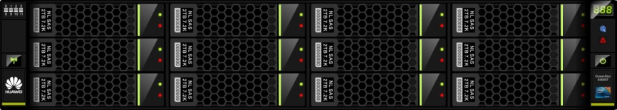
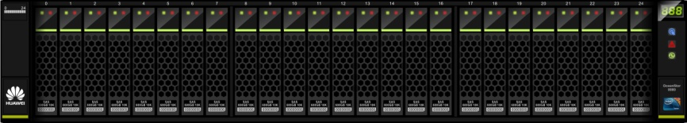

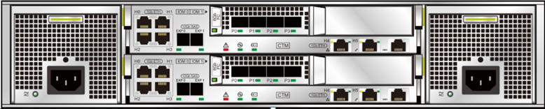
OceanStor 2200 V3 Entry-level Storage Product Hardware (Appearance)
SAS cascade ports
Two SAS ports on each controller
Filler panel
Fan built in the power-CBU module
1+1 redundancy
94% conversion rate
Support for 100V~240V AC and 240V HVDC
Interface module
1 hot-pluggable IO module slot, only for the frontend
Interface types: GE, 10GE electrical, SmartIO card (16G FC, 8G FC, 10Gb FCoE [VN2VF], and 10Gb Eth [optical])
On-board ports
4xGE ports on each controller
Notes:
This is the a’ppearance of an OceanStor 2200 V3's controller en’closure.
Let's look at the back view of the enclosure. As it shows in the picture , It is a fully redundant architecture. Both of the two modules have redundant controllers, it can reach 1 + 1 redundancy.
In the middle of the enclosure are two controller modules(‘madjul) , Each controller has four GE ports and two SAS ports onboard. One sas ports include 4 12GE SAS channel. For 2200 V3,there have one hot-pluggable interface module(madjul) in controller, it can be 4*GE,2/4 *10GE, 4(or 8) 8Gb FC or 2/4*16Gb FC except SAS ports, so the max(manks) number of host ports are 24=2*(4+8) (4 plus 8, and then multiply by 2), the max number of back-end ports are 4=2*2.
FC and IP ports mixing are rare in entry-level storage. For example, Netapp E,DELL MD can only support FC or IP
These three ports are used for manage. If needed, 2 of them can be converted to host ports. They are combo interface. The other one is RM serial port.
These is the power module, fan and CBU are in modules too.

Slide 4
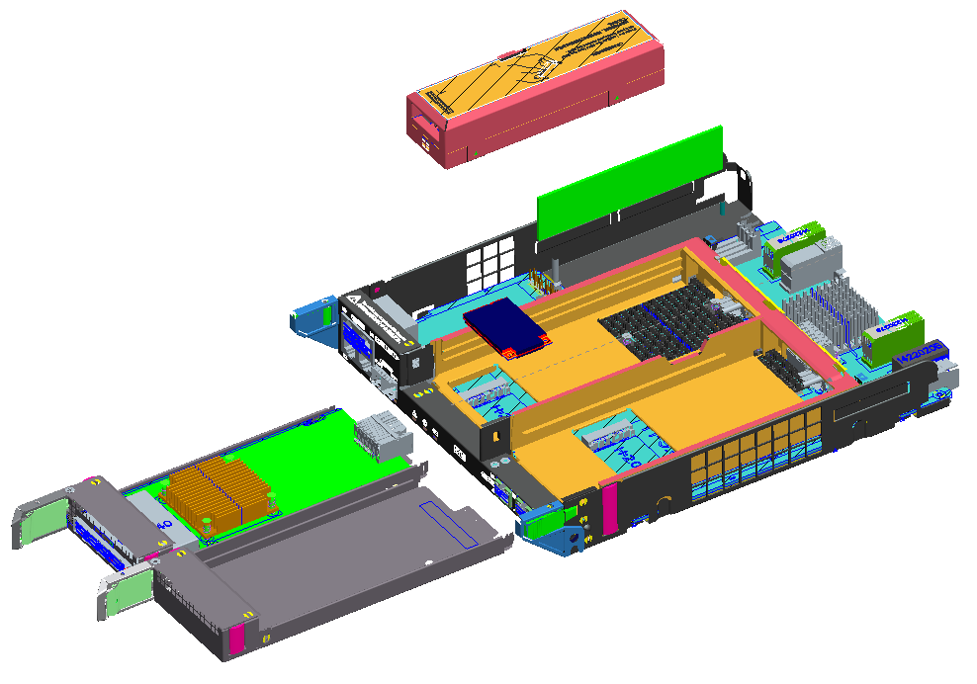
OceanStor 2200 V3 Entry-level Storage Product Hardware (Internal)
CBU
DIMM0
msata0
Interface card 0
① System enclosure ② Disk module
③ Power module ④ Controller
Filler panel
Notes:
This is the Ove’rall structure of a 2 U 25-disk controller enclosure. It consists of System enclosure, disk module , power module and the controller.
This is the control board(bo:d). There are two 16GB msata to store the data of os, the write cache data before power down etc
And the CBU is supercapacitance(ke’pansitens) backup unit. When the power is down accidentally(anksidenteli), the CBU will support the controller power to write cache to mSATA. 2200 V3 is not used BBU, because CBU life is longer. Battery write times is limited. But CBU can only used for small-capacity cache just because of the Capacitance capacity.

Slide 5
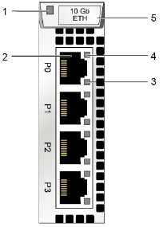
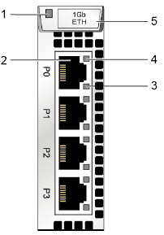
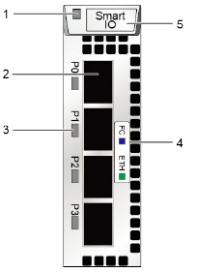
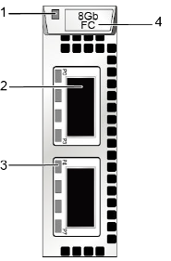
OceanStor 2200 V3: Abundant IO Interface Cards
4*10GE electrical card
4*GE electrical card
4*SmartIO card
2*SmartIO card
8*8G FC card
Supports 8Gb FC, 10Gb iSCSI, & 16Gb FC.
Supports 10Gb iSCSI and 16Gb FC.
HD ports, requiring dedicate cables
All IO interface cards support hot plug.
Notes:
There are the io cards of 2200 V3. Pay attention to the 2 smart IO ports card. It is designed to reduce business price. It can only be used in 2200 V3
8 ports 8GB FC high density card is designed to meet the special command ,when connection environment is no FC switch. But the fiber cable should be special. you can find the prompt(prampt) in the SCT-Huawei website for quotation.

Slide 6
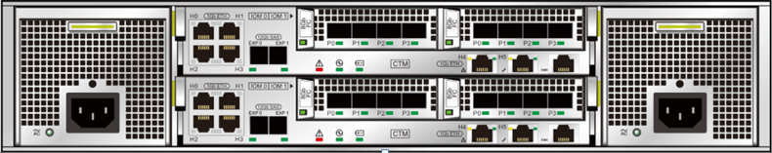
OceanStor 2600 V3 Entry-level to mid-range Storage Product Hardware (Appearance)
SAS cascade ports
Two SAS ports on each controller
Interface module
2 hot-pluggable IO module slots,
Interface types: 8Gb FC, GE, 10GE electrical, 12Gb
SAS, SmartIO card (16G FC, 8G FC, 10Gb FCoE [VN2VF], 10Gb Eth [optical])
Fan built in the power-CBU module
1+1 redundancy
94% conversion rate
Support for 100V~240V AC, 240V HVDC and -48V~-60V DC
On-board ports
4xGE ports on each controller
Notes:
OceanStor 2600 V3 has a similar hardware appearance to 2200 V3. there are two modules slots in one controller.
And 2 ports card are not supported.

Slide 7
OceanStor 2200&2600 V3 disk enclosure
2U enclosure supporting 25 disks
4U enclosure supporting 24 disks
Each ring supports cascading of up to 8 disk enclosures. 2200 V3 supports two rings and cascading of 11 disk enclosures at most (meaning 300 disks can be supported).
Notes:
Two types disk enclosure are supported. 2U 25 disks and 4U 24 disks. It is same with all V3. high density enclosure are not supported.
For 2200 V3 ,it have only 4 SAS ports to expend disk enclosure. So it can only support two loops, the max number of disk enclosure is up to 8, but to 2200 V3, only 11 disk enclosures are cascaded(kan’skeid), so the max disks number are 300.

Slide 8
Contents
1
OceanStor 2200 V3 and 2600 V3 Introduction
2
Quotation guide
Notes:
This training consists of three parts: product overview, OceanStor 2200(twenty-two hundred) V3 and OceanStor 2600(twenty-six hundred) V3 introduction. Product highlights, competition, configuration and other informations will be involved in the introduction.
Let's start with the first part.

Slide 9

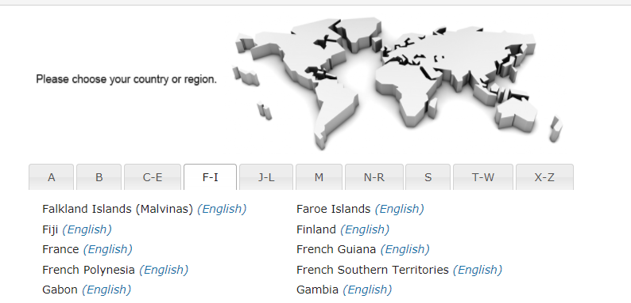
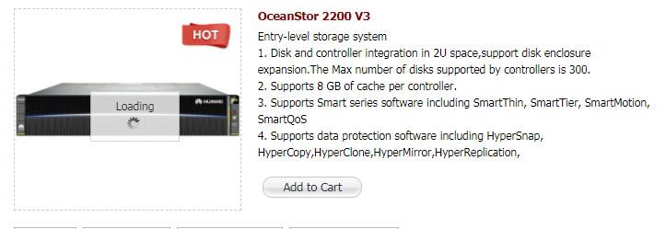

Quotation tool-SCT
SCT
eDesigner
Quotation website: http://unistar.huawei.com/sct/login!loginChoose.action
Choose the region/country and register, login
Choose the product and add to cart
Choose the product in the cart, then do the quotation
Set the Project Basic info

Slide 10

Quotation Items and steps
SCT
eDesigner
Storage Form
SAN or SAN-NAS integration
Controller enclosure specifications (Cache, disk size)
Controller Enclosure
Hardware
Disk types (SSD, SAS, NL-SAS)
Storage Unit
Disk enclosure
Auxiliary Devices
SAS cable
Software
Value-added Software
Value-added storage software
Service
Installation and maintenance
Notes:
Now，let‘s see the quotation guide. Quotation pro’ced(j)ures of OceanStor 2200 V3 are similar to those of OceanStor V3 mid-range storage series .
The diffence between 22 and V3 is:
2200 V3 can not select the version.
And 2200 V3 need not select the multi-controller because it noly support 2.

Slide 11
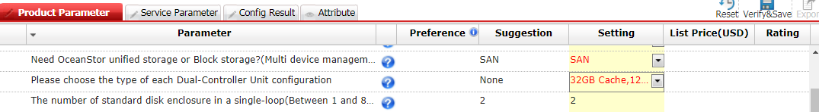
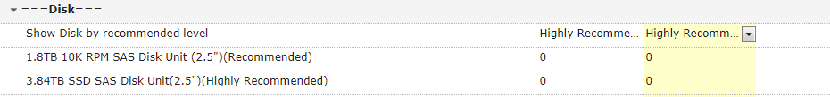
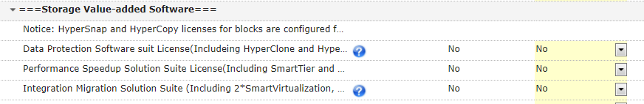

Recommend/all

Slide 12
Precautions on Interface Modules
SCT
eDesigner
Configuration Item | Description
4 x GE I/O modules (4 ports) | Optional, configured in pairs
8 x 8 Gbit/s FC I/O modules (QSFP+) | Optional. High-density cards. Use QSFP+ interfaces. Pay attention to the form. For details, see related technical white papers.
4 x SmartIO modules (SFP+, 10GE) | Optional. Configuration in pairs. Supports 10GE and FCoE (VN2VF).
4 x SmartIO modules (SFP+, 8 Gbit/s FC) | Optional, configured in pairs
4 x SmartIO modules (SFP+, 16 Gbit/s FC) | Optional, configured in pairs
2 x SmartIO modules (SFP+, 16 Gbit/s FC) | Optional, configured in pairs
2 x SmartIO modules (SFP+, 10GE) | Optional, configured in pairs
4-port 10GE I/O modules (RJ45) | Optional, configured in pairs
Notes:
These are the interface modules of 2200 V3. the 2 ports modules only support 10Ge and 16Gb FC. And the 8*8Gb high density module is special for cable.

Slide 13
Precautions on Software and Value-added Features
SCT
eDesigner
 | Software and Value-added Features | Description
Basic software package | Licenses for basic block storage (DeviceManager, SmartThin, HyperCopy, HyperSnap, SmartMigration, SmartErase, SmartMotion, Cloud Service, SystemReporter) | Mandatory in SAN storage
 | Licenses for unified block storage (SmartQuota, NFS, CIFS, NDMP, SmartMulti-tenant) | Automatically configured when SAN upgrading to unified storage or SAN-NAS integration is selected.
File | HyperLock (WORM), HyperVault (all-in-one backup) | Quotation of the file engine software: Select file features. Features in red have been packed in basic software packages. Select other NAS value-added features as required.
Block | HyperMirror, SmarTier, SystemReporter, SmartVirtualization,HyperClone | Value-added features are optional.
Shared features of file and block storage | HyperReplication, SmartCache, SmartQoS, SmartMotion | Optional value-added functions shared by block and file storage. Configure one license to enable feature sharing.
The block feature package of OceanStor 2200 V3 contains snapshot and volume copy.
Notes:
The basic block soft suits is commanded at any configurations. snapshot and lun copy are included in basic suit rather than the other model. They are free in 2200 V3.
If you choose san and nas, the upgrade block to unified software are added.
If the value-added software is supported both block and file , it only needs to make quote once. For example, snapshots, regardless of block or file snapshots have been included in the basic function of the package.

Slide 14
Service Quotation Strategy: Engineering Installation + Hardware Maintenance + Software Maintenance (Mandatory)
SCT
eDesigner
Quotation Item | Description | Optional or Mandatory
Installation service -OceanStor 2200 V3 | Configuration based on the storage quantity | Optional
Co-Care Standard 9*5*NBD Service (3/4/5/6 years) | Warranty services are upgraded to higher levels. | Optional
Co-Care Premier 24*7*4H Service (3/4/5/6 years)
Hi-Care Onsite Standard 9*5*NBD Engineer Onsite Service (3/4/5/6 years)
Hi-Care Onsite Premier 24*7*4H Engineer Onsite Service (3/4/5/6 years)
Software Technical Support Service–Basic Software (/license/year) | 1. Software does not contain maintenance services. The software can be replaced within 90 days since the delivery date. 2. The service periods of software and hardware in the same project must be the same (3, 4, 5, or 6 years). Thus, the software service should be selected to at least 3 years by default. 3. Software services and software function licenses have the same authorization. | Mandatory
Software Technical Support Service–Value-added Software (/license/year)
Devices within the three-year warranty can be replaced when fail . Optional: Upgrade to Co-Care (By Partner) or Hi-Care (By OEM) services.
Notes:
Software does not contain maintenance services. The software can only be replaced within 90 days since the delivery date if any maintenance are not quoted. So 3 years upgrade service should be added.
Co care and hi care means on-site service. If customer demand, add it.

Slide 15
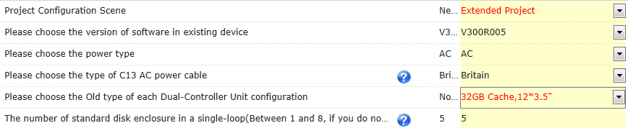
SCT
eDesigner
Capacity Expansion Configuration
Select Extended Project in Project Configuration Scene.
Choose the software version, power supply, AC power cable types, and cache specifications.
1. Select an expansion scenario.
1
2. Select SAN or SAN+NAS.
2
3. Select AC.
3
4. Choose the type of AC power cables.
4
5
5. Select cache specifications.
6
6. Set the number of disk enclosures in a single loop.
Notes:
For e’xpansion configuration, you can choose the extended project rather than 2200 V3 spares. For 2200 V3, all the model are delivered by sparts, you can assemble 2200 V3 on site.

Slide 16
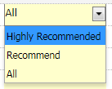
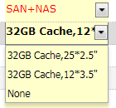
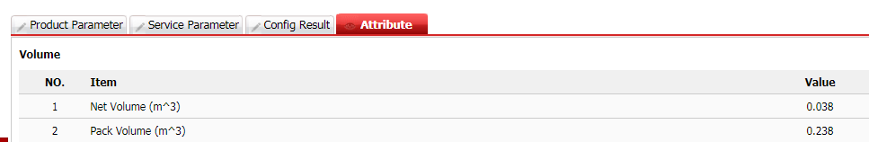
SCT
eDesigner
FAQ for the quotation
Q: Why can’t find the disk which show supported in Huawei website?
A: In disk area, choose all option.
Q: Why can’t choose16G Cache in 2200 V3?
A: 2200 V3 SAN+NAS only support 32G Cache.
Q: No error when don’t choose any interface card?
A: The SCT will automatically check the error in Product Parameter. No error for without interface card because 2200 and 2600 V3 have integrated interface cards.
Q: What feature else for the SCT?
A: You can find the power consumption, etc at Attribute page.
Set Discount and share, export, etc.

Slide 17
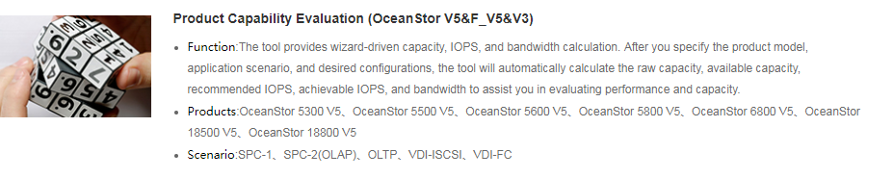
SCT
eDesigner
Product Capacity/Performance Evaluation- eDesigner
Web site: http://app.huawei.com/unistar/edesigner/login!index.action
Register and login, choose Enterprise and country.
Choose Home -> IT->Storage->Enterprise storage-> Product Capability Evaluation (OceanStor V5&F_V5&V3)

Slide 18
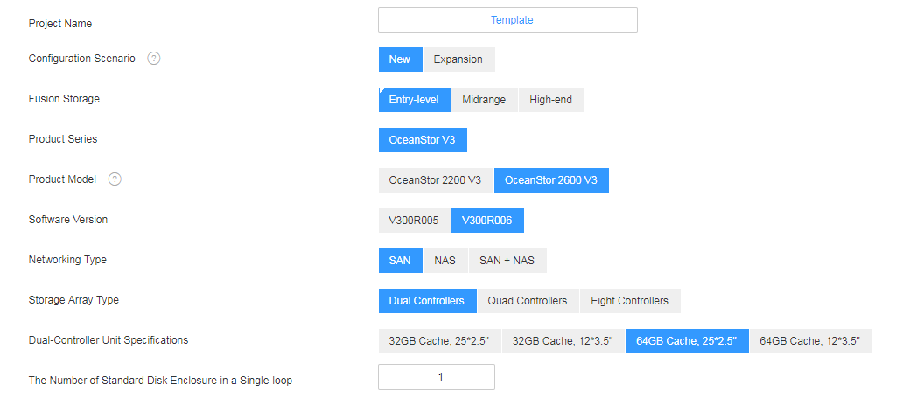
SCT
eDesigner
How to evaluate the OceanStor 2200/2600 V3
1. Basic part:
1.1 Design Solution Page, Input the project name(The name you will use for the SCT configuration);
1.2 Choose Entry level and 2200 or 2600 V3;
1.3 Choose SAN/NAS/SAN+NAS;
1.4 Choose controller quantities
1.5 Choose cache
2. Service part:
2.1 Choose the service type;
2.2 Choose Disk configuration;
Include disk type, disk numbers, RAID type, etc.
2.3 Option choose service and others (eg: AC/DC) if you want to submit the result to SCT to automatic configuration.
3. Finish Design
3.1 check all results;
3.2 Export result/Adjust/Archive to share/Submit to SCT as which you need.

Slide 19
Notes:
That's all for this training session. Thank you for tuning in.

