Slide 1
OceanStor 2200 V3 Converged Storage Quotation Guide (Outside China)

Slide 2
Contents
1
Key Quotation Items
2
Quotation Guide
3
Configuration Instance

Slide 3
System Specifications
Product Name | OceanStor 2200 V3
Hardware Specifications
Number of supported disks | 300 | 300
Max. number of controllers | 2 | 2
Cache (dual-controller) | 16 GB | 32 GB
Max. number of front-end host ports (dual-controller) | 24 | 40
Software Specifications
SAN-NAS integration | Not supported | Supported
Data protection software | HyperCopy (LUN copy), HyperClone (clone), HyperMirror (volume mirror), HyperSnap (snapshot), HyperReplication (remote replication) | HyperCopy (LUN copy), HyperClone (clone), HyperMirror (volume mirror), HyperSnap (snapshot), HyperReplication (remote replication), HyperVault (integrated backup), HyperLock (WORM)
Mission-critical business guarantee | SmartQoS (intelligent service quality control) | SmartQoS (intelligent service quality control)
Enhanced resource efficiency | SmartTier (intelligent data tiering), SmartCache (intelligent SSD cache), SmartThin (thin provisioning), SmartMotion (intelligent data relocation), SmartMigration (LUN migration), SmartErase (data destruction), SmartVirtualization (heterogeneous storage virtualization) | SmartTier (intelligent data tiering), SmartCache (intelligent SSD cache), SmartThin (thin provisioning), SmartMotion (intelligent data relocation), SmartMigration (LUN migration), SmartErase (data destruction), SmartVirtualization (heterogeneous storage virtualization)
Ease-of-Deployment
Easy-to-deploy architecture | The more delicate architecture design provides compacter sizes plus lower working noises and power consumption with easier deployment environments, meeting requirements of customers who lack professional equipment rooms.
Easy-to-configure | SmartConfig enables one-minute device configuration with three easy steps, allowing IT personnel to quickly learn how to configure devices without having to understand the complexities of the storage technology.

Slide 4
Hardware Architecture
Cascaded SAS interfaces
2 x SAS 3.0 interfaces per controller
Filler panel
Integrated power/fan modules
1+1 redundancy
AC: 100 V to 240 V (adaptive to 240 V high-voltage DC)
Interface module
1 hot-swappable I/O module slot (only for front-end)for 16GB Cache， 2 hot-swappable I/O module slot (only for front-end)for 32GB Cache
Interface type: GE, 10GE electrical ports, and SmartIO card (16 Gbit/s and 8 Gbit/s FC, 10 Gbit/s FCoE (VN2VF), 10GE optical ports)
Onboard interfaces
4 x GE interfaces per controller

Slide 5
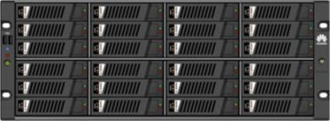
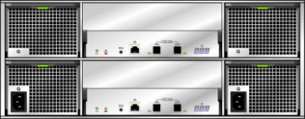
Disk Enclosure Architecture
2 U (25 disks, 2.5'')
4 U (24 disks, 3.5'')
Disk module
Disk module
Fan modules
Power modules
Expansion module
Expansion module
Power modules

Slide 6
Contents
1
Key Quotation Items
2
Quotation Guide
3
Configuration Instance

Slide 7
Quotation Items
Storage Form
SAN or SAN-NAS integration
Controller Enclosure
Controller enclosure specifications (large or small disks)
Disk types (SSD, SAS, and NL-SAS)
Storage Unit
Disk enclosure
Auxiliary Devices
SAS cable
Value-added Software
Value-added storage software
Service
Installation and maintenance

Slide 8
Steps to Configure OceanStor 2200 V3
Optional
Go to UniStar eCFG/SCT.
Select a product model.
OceanStor 2200 V3
Select SAN or SAN+NAS integration.
Select a storage type as required.
Select a controller enclosure.
Select front-end expansion I/O modules.
Select disk types and quantities.
Specify installation materials.
Select value-added software features.
Select detailed specifications.
Select the disk type and quantity.
Notes:
OceanStor 2200 V3 can only be configured with front-end interface modules. Each 8GB controller can be configured with 1 front-end interface module. Each 16GB controller can be configured with 2 front-end interface module.
Cache sizes for disks: a. SAN+NAS integration: 32 GB; b. SAN: 16 GB
Select optical fibers, SAS cables, and modems.
Select value-added software features.

Slide 9
Precautions on Interface Modules
Configuration Item | Description
4 x GE I/O modules (4 ports) | Optional, configured in pairs
8 x 8 Gbit/s FC I/O modules (QSFP+) | Optional. High-density cards. Use QSFP+ interfaces. Pay attention to the form. For details, see related technical white papers.
4 x SmartIO modules (SFP+, 10GE) | Optional. Configuration in pairs. Supports 10GE and FCoE (VN2VF).
4 x SmartIO modules (SFP+, 8 Gbit/s FC) | Optional, configured in pairs
4 x SmartIO modules (SFP+, 16 Gbit/s FC) | Optional, configured in pairs
2 x SmartIO modules (SFP+, 16 Gbit/s FC) | Optional, configured in pairs
2 x SmartIO modules (SFP+, 10GE) | Optional, configured in pairs
4-port 10GE I/O modules (RJ45) | Optional, configured in pairs

Slide 10
Precautions on Software and Value-added Features
 | Software and Value-added Features | Description
Basic software package | Licenses for basic block storage (DeviceManager, SmartThin, HyperCopy, HyperSnap, SmartMigration, SmartErase, SmartMotion, Cloud Service, SystemReporter) | 16GB Cache
 | Basic Software License(Including DeviceManagement,HyperSnap,HyperCopy,SmartThin,SmartMotion,SmartErase,SmartConfig,SystemReporter,UltraPath,NFS,CIFS,NDMP,SmartQuota,SmartMulti-tenant)-32G Cache Only | 32GB Cache
File | HyperLock (WORM), HyperVault (all-in-one backup) | Quotation of the file engine software: Select file features. Features in red have been packed in basic software packages. Select other NAS value-added features as required.
Block | HyperMirror, SmarTier, SystemReporter, SmartVirtualization,HyperClone | Value-added features are optional.
Shared features of file and block storage | HyperReplication, SmartCache, SmartQoS, SmartMotion | Optional value-added functions shared by block and file storage. Configure one license to enable feature sharing.
The basic package of OceanStor 2200 V3 contains snapshot and volume copy.

Slide 11
Configuration Quote Description of Encryption
Encryption scheme:
1, Encrypted disk/encryption machine is a controlled sales component. SCT is not visible and it is a non-saleable country.
2, Support built-in dense pipe (no quote, no license control, optional encryption disk can support) and external encryption machine.
3, First configure the encryption disk, and then determine the encryption scheme.
Configuration steps:
1, Select the encrypted disk --- "2, Select the encryption.
1, Enter the number of encrypted hard disks.
2. Select the built-in None or Entry-level.

Slide 12
Quotation Description of SafeNet HSMs
Configuration methods:
1. First configure the encryption disk, then increase the encryption model and maintenance services. The configuration rules of the encryption machine are as follows:
Function | Quotation Description | Configuration Rules
Key management server | K250 KeySecure, V8.5, Perpetual | It is advised to configure two key management servers for each site by considering the active-standby mode. One server is acceptable.
Warranty service of key management servers | Plus Maintenance Support - K250 KeySecure-1 Year-7*24 | Configure warranty quantity based on the server quantities. Warranty quantity = Required warranty period x Number of key management servers
Client license | GEMALTO KMIP Connector, Perpetual License | Number of clients = Number of storage arrays
Client license warranty service | Plus Maintenance Support - KMIP Connector- 1 Year-7*24 | Warranty period of client licenses = Number of clients x Required warranty period. For example, when three storage arrays need a 3-year warranty, enter "9" in the SCT.
Vender/Model | Security Level | Max. Number of Keys(Number of encrypted hard disks) | Ma. Number of Clients( Management array number) | Cost
SafeNet: K250 | FIPS 140-2 Level 1 | 25,000 | 100 | Low

Slide 13
Precautions on Installation Materials
Installation Materials | Description
Patch Cord,DLC/PC,DLC/PC,Multi-mode,3m,A1a.2,2mm,42mm DLC,OM3 bending insensitive | Automatically configured based on the number of host Fibre Channel ports. The default length is 3 m. If you need to configure additional cables, select your desired quantity separately.
Patch Cord,DLC/PC,DLC/PC,Multi-mode,10m,A1a.2,2mm,42mm DLC,OM3 bending insensitive
Patch Cord,DLC/PC,DLC/PC,Multi-mode,20m,A1a.2,2mm,42mm DLC,OM3 bending insensitive
Patch Cord,DLC/PC,DLC/PC,Multi-mode,30m,A1a.2,2mm,42mm DLC,OM3 bending insensitive
Patch Cord,DLC/PC,DLC/PC,Multi-mode,40m,A1a.2,2mm,42mm DLC,OM3 bending insensitive
Patch Cord,DLC/PC,DLC/PC,Multi-mode,50m,A1a.2,2mm,42mm DLC,OM3 bending insensitive
Patch Cord,DLC/PC,DLC/PC,Multi-mode,60m,A1a.2,2mm,42mm DLC,OM3 bending insensitive
Patch Cord,DLC/PC,DLC/PC,Multi-mode,80m,A1a.2,2mm,42mm DLC,OM3 bending insensitive
Patch Cord,DLC/PC,DLC/PC,Multi-mode,100m,A1a.2,2mm,42mm DLC,OM3 bending insensitive
High Speed Cable,48G Mini SAS HD Cable,3m,(SFF 8644 Plug),(28AWG*4P*2B(S)),(SFF 8644 Plug),Indoor,SAS 3.0,N | Automatically configured according to the disk enclosure quantity. If you need to configure additional cables, select your desired quantity separately.

Slide 14
Capacity Expansion Configuration
Select Extended Project in Project Configuration Scene.
Choose the software version, power supply, AC power cable types, and cache specifications.
1. Select an expansion scenario.
1
2. Select SAN or SAN+NAS.
2
3. Select AC.
3
4. Choose the type of AC power cables.
4
5
5. Select cache specifications.
6
6. Set the number of disk enclosures in a single loop.

Slide 15
Service Quotation Strategy: Engineering Installation + Hardware Maintenance + Software Maintenance (Mandatory)
Quotation Item | Description | Optional or Mandatory
Installation service -OceanStor 2200 V3 | Configuration based on the storage quantity | Optional
Co-Care Standard 9*5*NBD Service (3/4/5/6 years) | Warranty services are upgraded to higher levels. | Optional
Co-Care Premier 24*7*4H Service (3/4/5/6 years)
SSD Co-Care Standard 9*5*NBD Service (3/4/5/6 years)
SSD Co-Care Premier 24*7*4H Service (3/4/5/6 years)
Hi-Care Onsite Standard 9*5*NBD Engineer Onsite Service (3/4/5/6 years)
Hi-Care Onsite Premier 24*7*4H Engineer Onsite Service (3/4/5/6 years)
SSD Hi-Care Onsite Standard 9*5*NBD Engineer Onsite Service (3/4/5/6 years)
SSD Hi-Care Onsite Premier 24*7*4H Engineer Onsite Service (3/4/5/6 years)
Software Technical Support Service–Basic Software (/license/year) | 1. Software does not contain maintenance services. The software disks can be replaced within 90 days since the delivery date. 2. The service periods of software and hardware in the same project must be the same (3, 4, 5, or 6 years). Thus, the software service should be selected to at least 3 years by default. 3. Software services and software function licenses have the same authorization. | Mandatory
Software Technical Support Service–Value-added Software (/license/year)
Devices within the three-year warranty can be replaced when fail (Western Europe excluded). Optional: Upgrade to Co-Care (By Partner) or Hi-Care (By OEM) services.

Slide 16
Contents
1
Key Quotation Items
2
Quotation Guide
3
Configuration Instance

Slide 17
Configuration Instance
Customer Requirements:
AC power supply environment, equipment cache ≥ 16 GB
SAN storage system
50 x 900 GB (10k rpm, 2.5") SAS disks + 6 x 600 GB SSDs
Front-end interfaces: 8 x 8 Gbit/s FC, 8 x GE iSCSI
HyperSnap.
SmartThin.
SmartVirtualization.
Configure the installation service and 3-year 24/7 Co-Care response

Slide 18
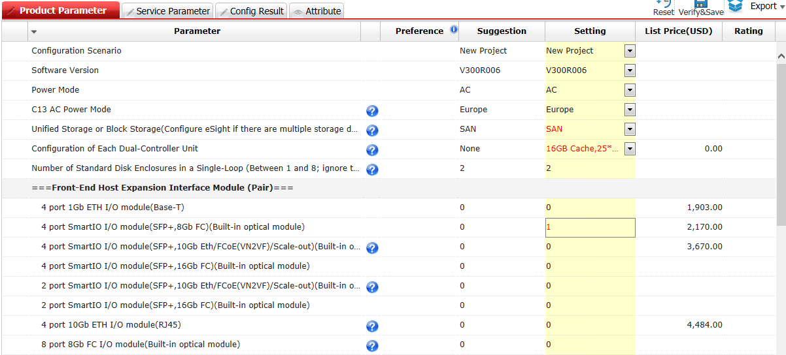
Selecting Controller Enclosures and Interface Modules
Select SAN and set the controller quantity to dual.
Select controller enclosure specifications. Choose 2.5'' enclosures in configuring this project.
Select interface types. The 2200 V3 is equipped with onboard GE interfaces, so configure 8 Gbit/s FC interfaces in this project.

Slide 19
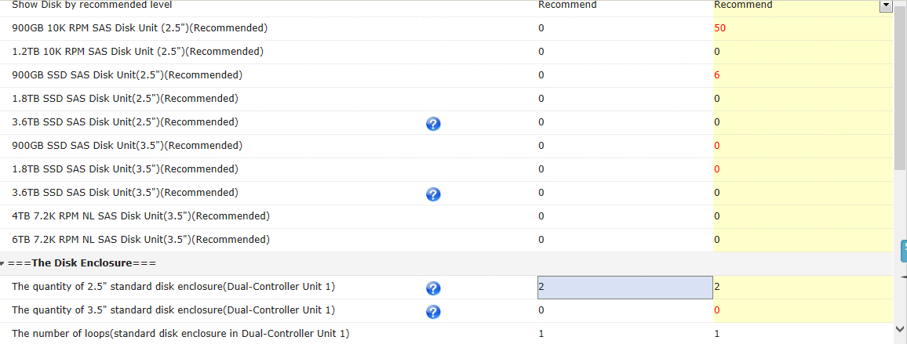
Selecting Disk Units
Select a disk unit based on project requirements.
Notes for users: The disk enclosure quantity is automatically calculated based on the number of disks. The total number of loops is calculated based on the total number of enclosures and the number of enclosures in a single loop.

Slide 20
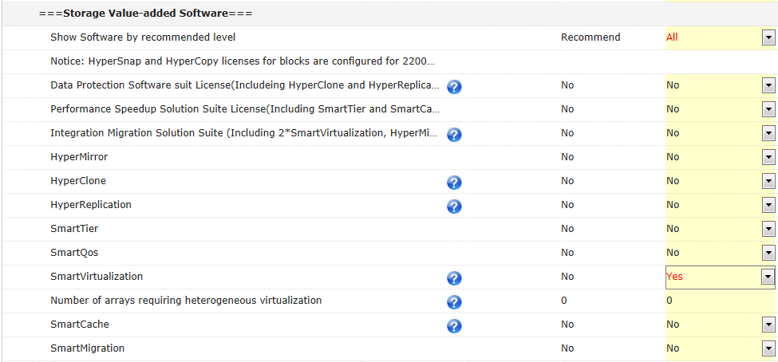
Selecting Installation Materials, Auxiliary Devices, and Software
Configure SmartVirtualization.
No need to configure the block feature package. By default, the block feature package contains HyperSnap and SmartThin.

Slide 21
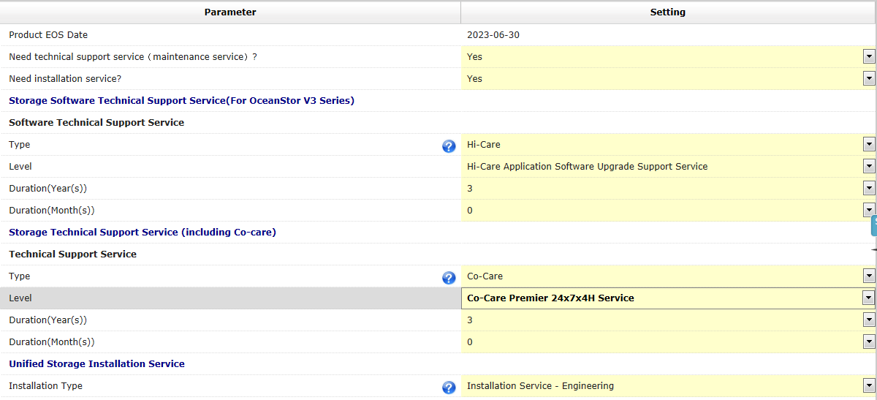
Selecting Services: Engineering Installation + Hardware Maintenance + Software Maintenance (Mandatory)
Select implementation services based on project requirements.
Three-year software upgrade service (mandatory)
Devices within the three-year warranty can be replaced when fail (Western Europe excluded).Configure 3-year Co-Care Premier 24x7x4H service in this project.

